Slide 1
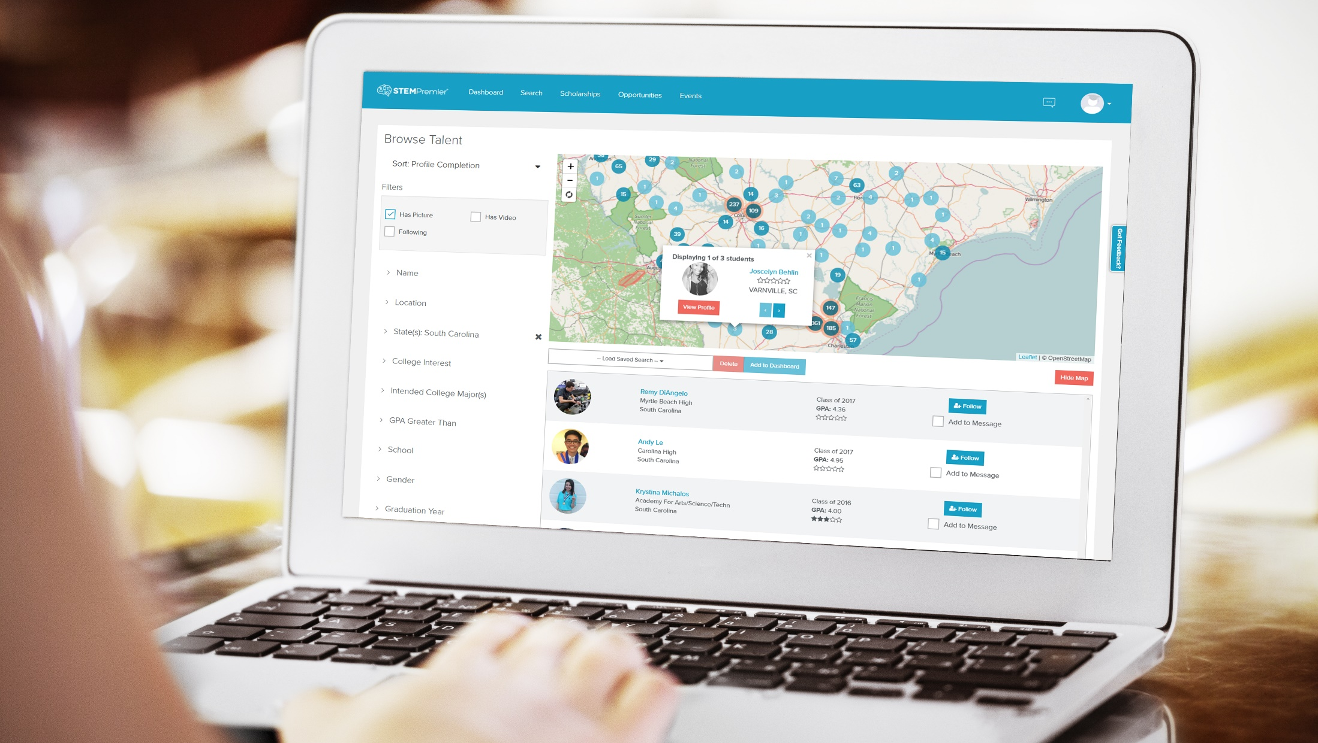
NACFAM Conference 2017 | 09.07.2017

Slide 2
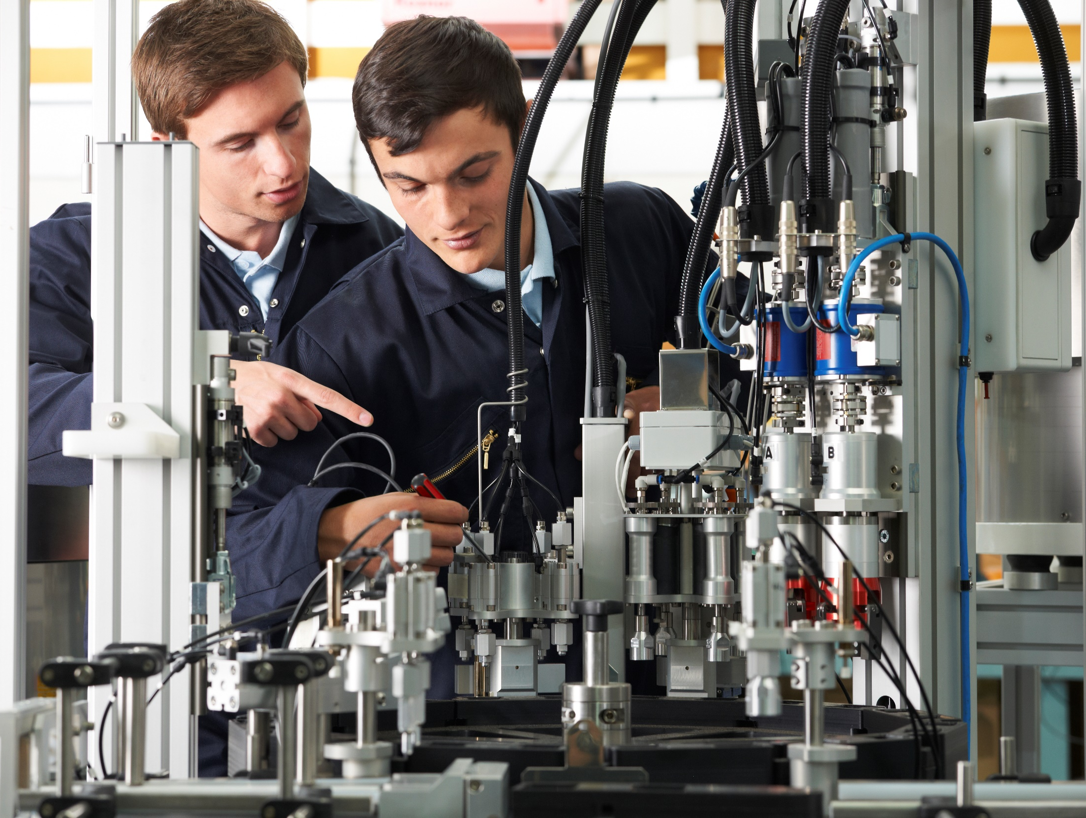
STEM Premier: It’s impact on Advanced Manufacturing’s Workforce Pipeline in the Present and Future
Presenters:
Casey Welch | COO & Co-Founder
Shea Tighe | National Dir. Of Engagement

Slide 3
What are we going to talk about?
Who are we and who uses STEM Premier
How are we impacting Advanced Manufacturing
Case Studies
State Model Driven by Advanced Manufacturing
How to Engage & Connect with the future talent pipeline
Questions?

Slide 4
So, What’s The Problem?
We all know about the aging workforce.
We all know about the skills gap.
We’re trying to relate and connect with the next generation.
How do we do it?

Slide 5
Question for you:
Has anyone in this room ever been recruited
– athletics, etc.
What was that like? Can you share your experience?

Slide 6
Athletic Recruiting
They’re doing it right. Proactive vs Reactive
Athletic talent is discovered, engaged, and recruited early.
STEM Premier works the same way.

Slide 7
Resources
What is STEM Premier?
A virtual hub
Scholarship Opportunities
Tools, Certifications
Programs
Guidance &
Coaching
Middle &
High School
Technical School & University
Talent Seekers
Talent
Technical School & University
Companies
Professional Level
Organizations
Guidance & Parents
Industry Mentors
Teachers
Mentorship
Notes:
Scalable

Slide 8
A “LinkedIn” For The Next Generation

Slide 9
A Little More About Us
STEM Premier at a glance
Our growing student population represents
over 13,000 schools in all 50 states
Our growing member population represents over 19,000 schools
in all 50 states
270,000+
National student users
National Partnerships
Most widely taken college entrance exam company in the country
Largest engineering, biomedical, and computer science high school curriculum company in the country
Largest high school student healthcare association in the country
Leading 3D design, engineering, and entertainment software company
Scholarship matching engine providing access to over $20 Billion in financial aid

Slide 10
A Little More About Us
Some of our college & corporate partners
Colleges & Universities
Manufacturing Companies
and more…

Slide 11
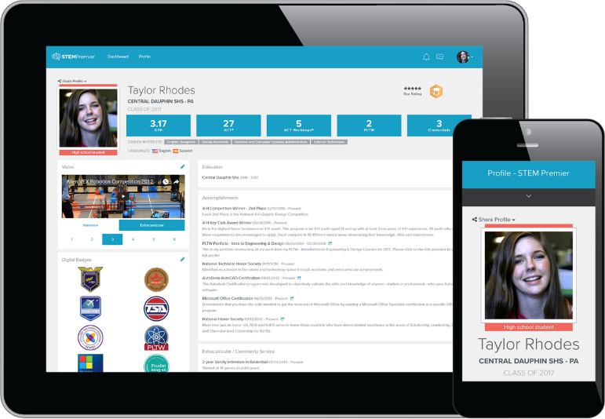
The Big Picture
How STEM Premier works for talent
Students:
Showcase your talent

Slide 12
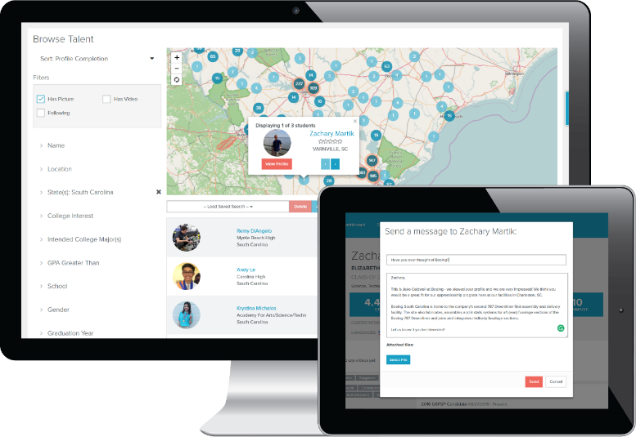
The Big Picture
How STEM Premier works for industry
Industry:
Find & connect with talent

Slide 13
Case Studies:
Advanced Manufacturing
Apprenticeships
Early Awareness
Student Recognition

Slide 14
Case Study- Cummins Turbo Technologies
Diesel Technician Apprenticeship Program
Cummins Turbo Technologies needed to fill 10 Diesel Technician Apprenticeship slots nationally – and could not find applicants. With STEM Premier, Cummins was able to identify the right fit for their program and message candidates whose interests and skills matched up with the opportunity. Within hours of messaging students and placing their application on STEM Premier, they had over 30 applicants from across the country. 5 of the 10 apprenticeship slots were filled by STEM Premier users.
Cody Corneglio| St. Bede Academy, Cummins Apprentice
“I am truly grateful that STEM Premier made the opportunity I have possible. It gives students the chance to get their name out there and find opportunities they would not know about otherwise. Although I had heard of Cummins, I had no idea they had a local presence or about this program, which would provide me with full-time employment, benefits, and financial assistance towards a college degree.”

Slide 15
Case Study – Highland Industries
Apprenticeship Program Awarenes
Highland Industries, a textile company in Cheraw, SC was in need of young people to apply for their apprenticeship program. They found that even though it was a small community, most students did not know anything about them or the opportunities they have available. With STEM Premier, they proactively identified students in their region that fit the mold for their Industrial Maintenance Apprenticeship, message them directly, and invite them to apply. Highland received 29 applicants in 3.5 weeks from graduating seniors in their community.
Preston Wilks| Hartsville High, Highland Apprenticeship Applicant
Preston’s Response to being invited to apply for apprenticeship program on STEM Premier: I'm just very excited that you’d offer me a chance to be a part of the Highland family. I have heard a lot about y'all and everything has been good. Once again thank you.

Slide 16
Case Study- Boeing
Boeing STEM Signing Day Recognition
Boeing South Carolina came to STEM Premier to power their inaugural STEM Signing Day – an event that would identify and recognize the top upcoming STEM talent in the state of South Carolina. Through a “Signing Day” event, 74 students from all 46 counties were selected and invited to the State House in Columbia and sign their “Letters of Intent” to pursue STEM majors/programs after high school. Students were discovered, engaged, and selected on STEM Premier.
Ethan Jackson | Wando High School, Signing Day Participant
“STEM Premier really is a wonderful tool but it definitely doesn't get the publicity that it deserves. As for the signing day, IT WAS AWESOME!!! I really didn't know what to expect because I had never heard anything like it before. I realized pretty quickly, however, that this was a big deal! I really appreciated the ceremony because it shed light on the importance of what we are doing and that there truly is a purpose and demand for us.”

Slide 18
Why?
The South Carolina Manufacturers Alliance (SCMA) discovered through its 200+ members that 40-50% of the workforce is retiring in 5-10 years.

Slide 19
SC Future Makers
A statewide initiative with the goal of introducing Advanced Manufacturing to the emerging talent in the state.

Slide 20
How is the initiative working?
200 high schools across the state of SC are joining STEM Premier to discover and connect with the companies in SC.

Slide 21
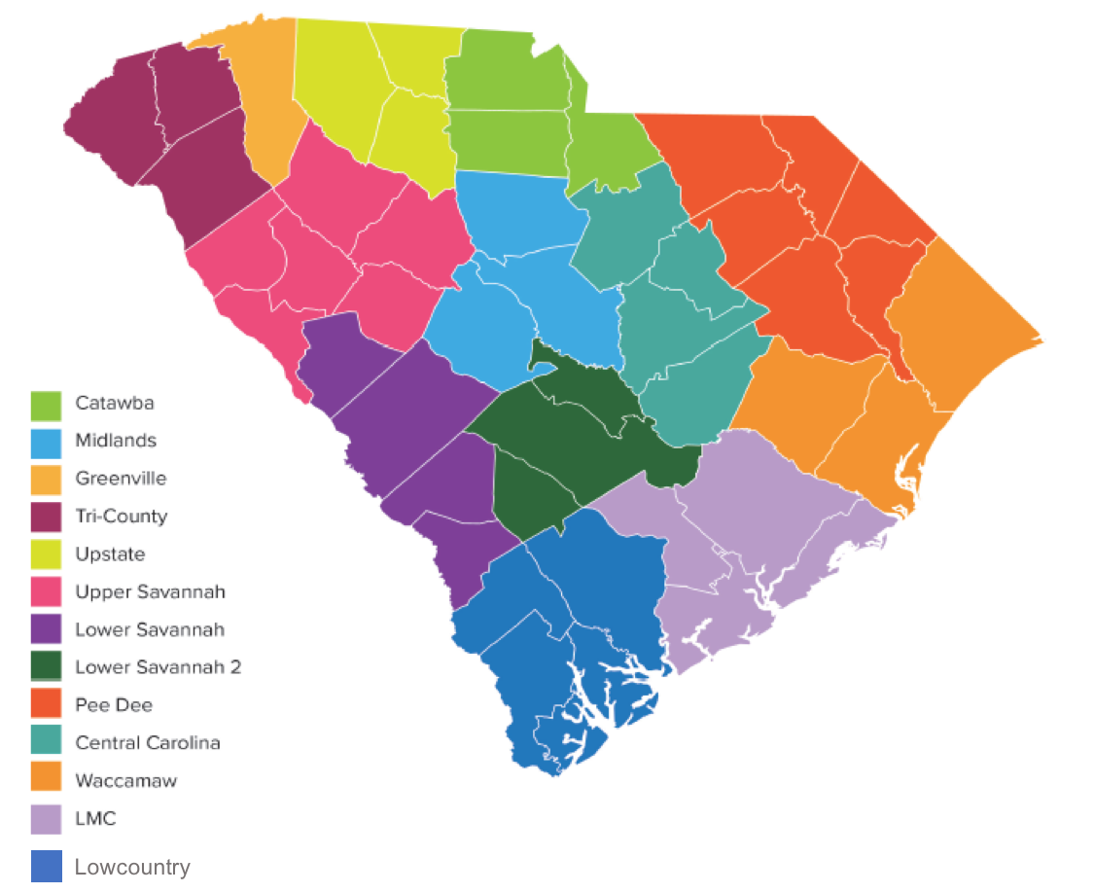
SC Future Makers Initiative
Bringing everyone together
200 High Schools
200,000+ students
16 Technical Colleges
SC Tech College System
4-Year Colleges
Transitioning Military
Industry
SC Manufacturing Companies
The next step for students and companies?
Join STEM Premier.
We’re the “what’s next”

Slide 22
So, What is the linchpin?

Slide 23
Another Question for you:
How any of you have looked at your smart phone since this presentation began?
Be honest.

Slide 24
Last Question:
How many of you have children who own smart phones?
How often are they on them?
Exactly.

Slide 25
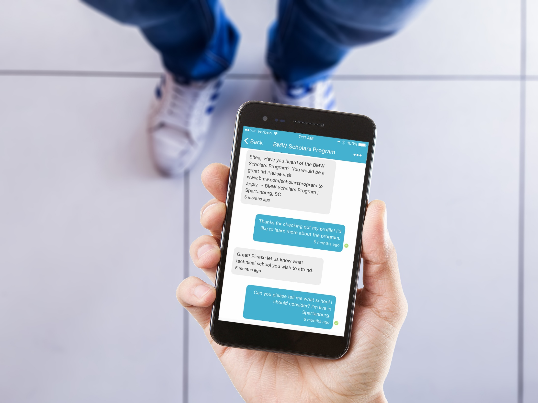

Slide 26
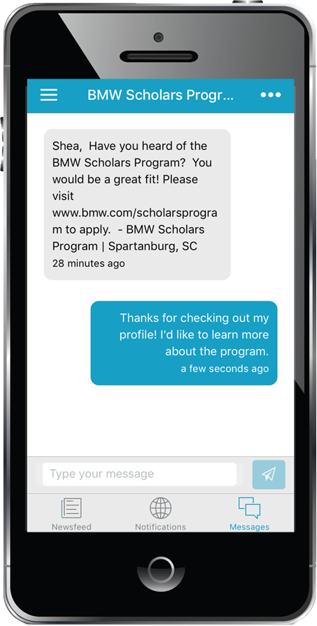
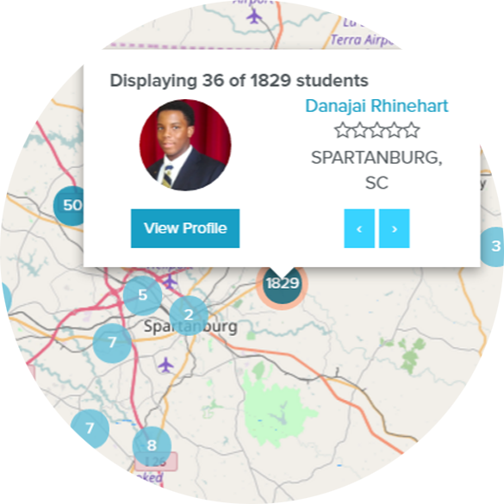
STEM Premier & The Mobile Experience
Engaging digital natives
Find talent
Engage directly
Cultivate & Recruit
Michelin
Danajai,
This is John with Michelin in Spartanburg, SC. We have a great program that would be a good fit – want to learn more?
That’s awesome! I’d love to learn more. Please let me know.
Future Talent Pipeline

Slide 27
We Play In Their Sandbox.
The key to building a sustainable talent pipeline:
Engage Students EARLY.
Engage them where they are.
Engage them directly.
Get to the point.

Slide 28
Questions?
Shea Tighe | stighe@stempremier.com
Casey Welch | cwelch@stempremier.com
www.stempremier.com

