Slide 1
Reshoring and FDI: 300,000+ jobs since 2010.
How to get millions more?
Harry Moser
President
Reshoring Initiative
NACFAM 2017

Slide 2
360,000 Mfg. Jobs Since 2007: Reshoring +FDI

Slide 3
Impact is Big
Manufacturing Jobs/Year
 | 2000-2003 Annual Average | 2016 | % Change
New Offshoring* | ~240,000 | ~50,000 | -80%
New Reshoring & FDI** | 12,000 | 77,000 | + 500%
Net Jobs Gained | ~-220,000 | ~+27,000 | N/A
* Estimated **Calculated

Slide 4
Reshoring + FDI Announcements Soaring
Source: Reshoring Library

Slide 5
Beating the trend. Still down 6M.

Slide 6
Trade Deficit Offers Potential for Huge
At a given level of domestic demand/consumption
The only way to grow manufacturing is to reduce the trade deficit, i.e.:
Export more, or
Import less, i.e. reshore
2016 U.S. Manufacturing: $2.2T
Manufactured Goods trade deficit, excluding petroleum:
$700B
32% of Mfg.
~38% after adjustment for price gap

Slide 7
How Many of the 6M Jobs Went Offshore?
Who | Loss to Automation | Loss to Offshoring
Prof. Hicks, Ball State Univ. | 87% | 13%/0.75M jobs
MIT, EPI, ITIF, RI | ~50% | ~50%/3-4M jobs

Slide 8
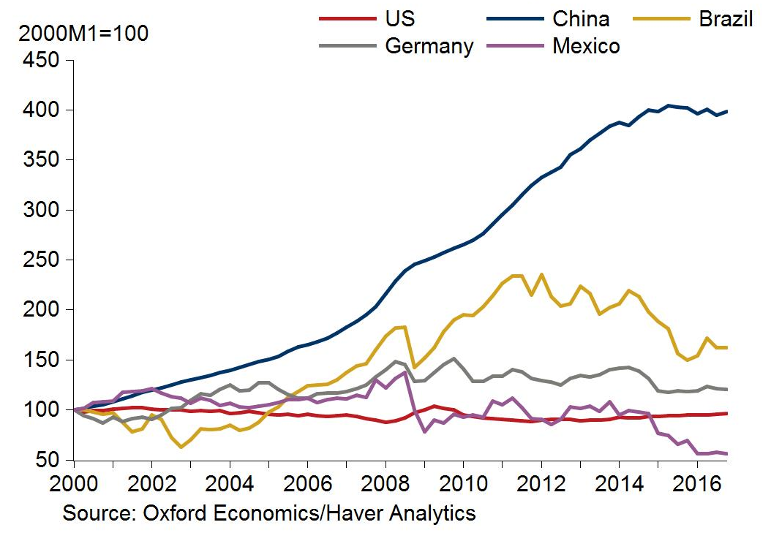
The Time is Right
Indexed Unit Labor Costs in Manufacturing in US$

Slide 9
Definitions
Reshoring/Backshoring/Onshoring/Insourcing: Bringing back manufacture of products that will be sold or assembled here.
FDI: Similar logic. Different owner.
Localization. Producing near the consumer.
Nearshoring: Mexico or Canada
U.S. potentially the biggest beneficiary.

Slide 10
The Industry-Led Reshoring Initiative Provides
Online Library of 4,000+ reshoring articles
Statistics from TCO and Library databases
Case Study template for posting cases.
Motivation for skilled manufacturing careers
Free Total Cost of Ownership (TCO) software for:
Companies for sourcing
Suppliers of parts and equipment for selling

Slide 11
TCO Comparison Example

Slide 12
TCO cases, China vs. U.S.
Comparison Basis | % of cases where U.S. has the advantage
Price | 5%
TCO | 53%
Difference | 48%*
*Conservatively 25% might return if companies shifted to TCO
Source: TCO user database

Slide 13
Circuit Boards
Woodridge, IL
Supplies heavy equipment companies
Had quality issue with a Chinese component
Found local IL source
Result:
Quality problem fixed
Inventory cut by 94%
$60M order

Slide 14
Reshoring More Effective than Exporting: U.S. is Much More Competitive at Home!
 |  | Where Sold
 |  | U.S. | China
Where Made | U.S. | $100 | $115
 | China | $100 | $85
Difference |  | 0 | 30%
Based on TCO being 15% higher for exports

Slide 15
Deming on Total Cost
“End the practice of awarding business on the basis of price tag. Instead, minimize total cost.”
Source: “4th Key Principle for Management,” Out of the Crisis, W. Edwards Deming

Slide 16
Offshoring Multiplies Waste
Toyota Wastes | Offshoring Contributes
Overproduction | Large batch shipments, filling containers
Waiting | Uncertain delivery/Inconsistent quality, port, customs, shared “awake time” window for discussions
Transport | 12,000 mi. inbound, 6,000 return (boat ½ full)
Overprocessing | More packing and unpacking, customs paperwork
Inventory | In transit, cycle, safety stock, uncertain delivery and quality, less ability to check and count
Motion | Increased cost over time – repetitive motion injuries or additional labor to compensate
Defects | Much higher than local sources, extra inspection of materials and tolerances, customers unhappy longer
Notes:
Harry,
I did this in case you plan to continue to use this slide for some shorter presentations.
Motion waste is movement of PEOPLE (as opposed to Transport – movement of product or material). This has the least perceived impact in offshoring, but ignoring motion waste is ultimately not sustainable. When people become overworked, they will compensate by adding people to continue meeting delivery and eventually will pass that cost on.
16

Slide 17
Industry 4.0
Advanced mfg. favors developed countries:
Less labor/unit of output
Required labor is higher skilled with smaller % wage difference vs. developing countries
More capital intense. Equipment is as or more expensive in other countries due to VATs.
Enables fast, customized customer response, impossible from Asia.

Slide 18
Virtuous Cycle: Reshoring/Productivity
Reshoring
Capacity
Utilization
Competitiveness
Investment
Productivity

Slide 19
Reshored & FDI’d Industries: Top 10
Industry | Jobs
Transportation Equipment | 98,232
Electrical Equipment, Appliances, Components | 35,388
Fabricated Metal Products | 20,413
Plastic/Rubber Products | 19,507
Computer/Electronic Products | 15,635
Apparel/Textiles | 13,903
Machinery | 13,561
Chemicals | 10,652
Wood Products | 9,853
Food & Beverage | 7,417
Sources: Reshoring Initiative Library.
Cases 2007 through 12/31/15.

Slide 20
Negative Issues Offshore: Top 10
Negative Reasons not to Offshore | Companies
Quality/rework/ warranty | 127
Freight cost | 100
Rising wages | 66
Total cost, TCO | 62
Delivery | 51
Inventory | 46
Supply chain interruption risk | 34
Communications, Intellectual property risk | 30 each
Loss of control | 25
Source: Reshoring Initiative Library, December 2015.
Notes:
20

Slide 21
Positive Reasons to Reshore: Top 10
Positive Reasons to Reshore | Companies
Lead time/time to market | 113
Image/brand | 87
Automation/technology (incl. 3D) | 70
Government Incentives | 48
Walmart | 42
Re-design of the part, Skilled workforce | 41 each
Manufacturing/Engineering joint innovation, R&D | 36
Higher productivity, Lean | 33 each
Source: Reshoring Initiative Library, December 2015
Notes:
21

Slide 22
Top Countries From Which Reshored
Global Region | Cases
Asia | 257
North America | 46
Western Europe | 13
Eastern Europe | 5
Country | Cases
China | 210
Mexico | 33
Canada | 13
Japan | 9
Taiwan | 7
Italy | 6
India | 5
Korea, Malaysia, Hungary | 2 each
Source: Reshoring Initiative Library,2010 through 2015.
Notes:
22
H, copy and paste into 2 slides or delete half if this is too dense.

Slide 23
Gaining support in Washington, DC
Commerce Dept:
2012 budget specifies TCO
Links:
http://nist.gov/mep/reshoring.cfm
http://business.usa.gov/program/reshoring-initiative
Major new site: http://acetool.commerce.gov/
Testified at Congressional hearing on 3/28/12
Working actively with SelectUSA
Calls from:
US-China Economic and Security Review Commission
White House National Economic Council

Slide 24
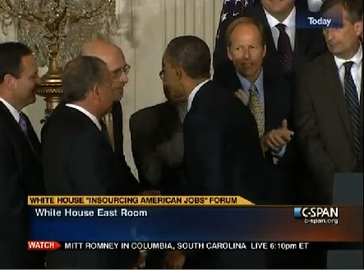
1/11/12 Insourcing Forum

Slide 25
But how do apprenticeships and credentials pay?

Slide 26
Virtuous Cycle: Reshoring/Skilled Workforce
Reshoring
Recruitment
Competitiveness
Skilled
Workforce
Productivity

Slide 27
Local Skilled Workforce Recruitment
Issue | Solution
“Trades” and “vocations” image | Call them “Professions”
Manufacturing career image due to offshoring | Help media report the local reshoring cases of the month. Use our Case Studies feature.

Slide 28
Recent Actions
First National Reshoring Award: metal cutting and forming
Reshoring Survey. Available. Due 10/15/17
How much offshored?
Why?
Price difference?
What policy changes would motivate reshoring?
Intellilink: Use of RPA (Robotic Process Automation) software to enable reshoring, FDI or retention of BOP (Back Office Processes)
CSRE
Competitiveness Toolkit
Import targeting service

Slide 29
Quantifying the Competitiveness Gap
TCO user database provides:
Ex-works product prices
User calculated “hidden” costs including quality, delivery, IP, etc.
By U.S. and other country (esp. China) and industry
→ % ex-works price and TCO competitiveness gaps
We know $ trade deficit by country and industry
We can:
Estimate the needed % improvement in U.S. price competitiveness to reduce the trade deficit by X%.

Slide 30
Competitiveness Toolkit
Factor | Model | Δ Price Advantage | Time to Implement
Skilled Workforce | Germany and Switzerland | 5%? | 10-20 years
15% Corp Tax Rate | Ireland | 2% | 1
15% VAT | Most of the World | 15%? | 1
$ Down 30% | Most of the World | 10% | 3
Regulations | ? | 3% | 5
Healthcare costs -30% | Germany | 3% | 15
Total |  | 38%

Slide 31
Eliminating the Trade Deficit
Trade Deficit, % Reduction | Number of Mfg. Jobs Brought Back | Δ Price vs. Imports | Time to Steady State*
30% | 1.2 million | -15% | 10 years
70% | 2.8 million | -25% | 15 years
100% | 4.0 million | -35% | 20 years
* Mainly due to workforce constraints.

Slide 32
Import Targeting
Will contractually provide data:
To EDOs, MEPs, manufacturers, trade associations and equipment suppliers to identify best reshoring/import substitution prospects
Searching by HS code, importer or offshore supplier.

Slide 33
What you can do
TCO:
Motivate companies to use it
Train MBAs and supply chain students
Partner with us:
Generally
On the Competitiveness Toolkit

Slide 34
Reshoring Manufacturing
Contact:
Harry Moser
Founder and President
847-726-2975
harry.moser@reshorenow.org
www.reshorenow.org
Useful links:
ACETool
Cost Differential Frontier
Total Cost of Ownership Estimator®
Skilled Workforce
Economic Development

Slide 35
A Message to Companies
Thinking about offshoring?
Before announcing, first use the free TCO Estimator to be sure offshore will really be more profitable
Ask yourself
Is it better to do the math today?
Or get a Tweet from Donald tomorrow!

Slide 36
Other proposed actions are, finally, ways to make the U.S. more competitive and reduce the trade deficit:
Innovation
Automation
Skilled Workforce
Taxes
Regulations

