Slide 1
Cybersecurity for
Advanced Manufacturing (CFAM)
An NDIA Joint Working Group

Slide 2
Session format
Introduction to cybersecurity in a manufacturing environment: Mike McGrath
NDIA Cybersecurity for Advanced Manufacturing Joint Working Group: Kaye Ortiz
Manufacturing network threats and implications: Rebecca Taylor
Manufacturing organization and culture: Chris Peters
CFAM consideration in existing policies, framework, and regulations: Larry John
Specific considerations for S&MEs: Kaye Ortiz
Existing and emerging technology: Mike McGrath
Q & A
Notes:
Best Practices:
Reduce/eliminate shared accounts
Limit access/change capabilities based on user accounts
Ensure controller consoles lock after a period of inactivity where possible
No external access from 3rd party vendor unless initiated by company (never by vendor alone or automatic)
Regular review of operating systems and applications for security updates
Disable external drive/USB auto-run where possible
Forced password changes

Slide 3
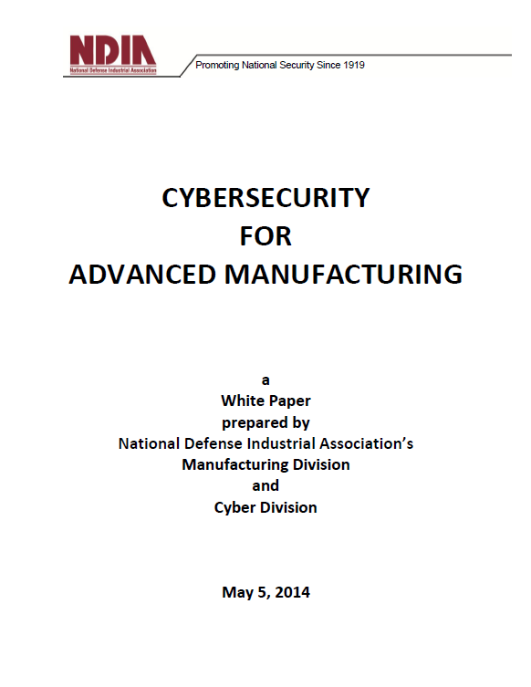
NDIA White Paper: National Security Implications
Cyber risks in defense industrial base are national security concerns
Theft of technical info -- can compromise national defense and economic security
Alteration of technical data -- can alter the part or the process, with physical consequences to mission and safety
Disruption or denial of process control -- can shut down production and impact readiness
Confidentiality
Integrity
Availability
www.ndia.org/Divisions/Divisions/Manufacturing

Slide 4


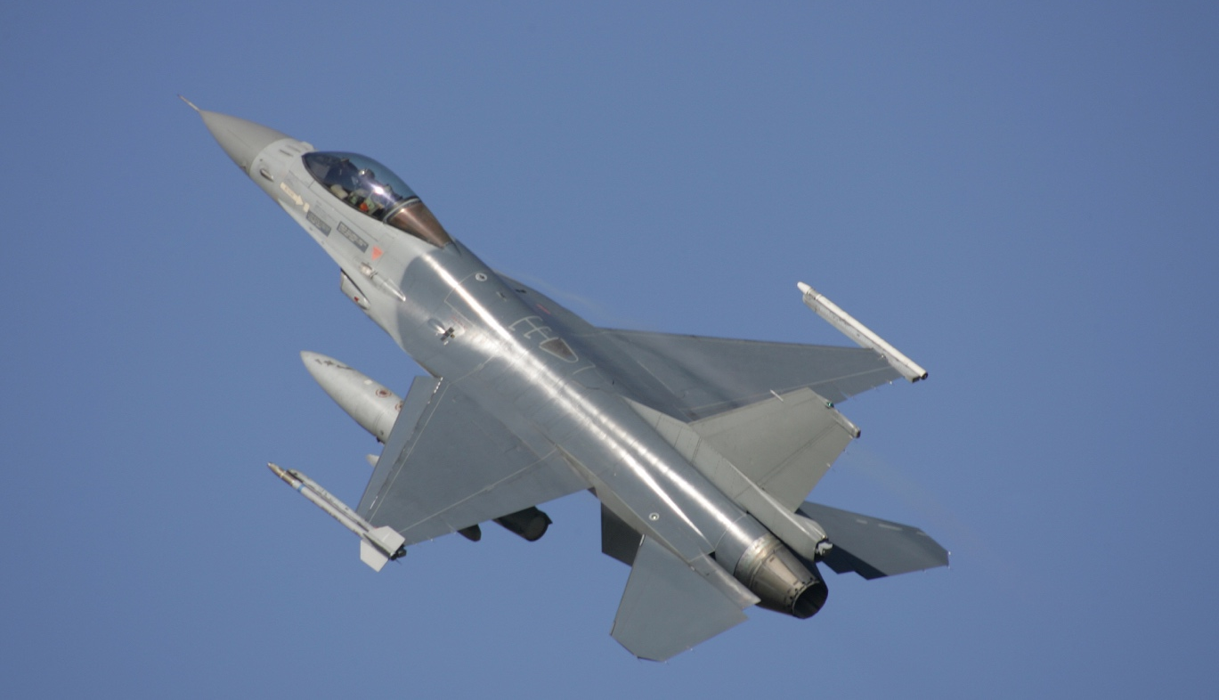

Study Elements
Manufacturing Cyber Threats
Special S&ME Considerations
Existing and Emerging Technology
National Defense Implications

Slide 5
NDIA CFAM JWG Vision – In Red Team Review
DoD and defense prime contractors are catalysts for creating a robust cyber-resilient U.S. industrial base connected through trustworthy manufacturing networks that respond rapidly to national security needs.

Slide 6
Top Level Recommendations
Establish, and adequately fund, a new program for manufacturing cybersecurity capabilities in the industrial base, with a DASD-level champion
Establish, and share the cost of, a Public-Private Partnership for Security in American Manufacturing
Incentivize industrial modernization for cyber-secure defense manufacturing through the use of innovative contracting authorities
Give high priority to R&D in cybersecurity for manufacturing through targeted project funding
Report and recommendations under review by Red Team comprised of seven government and seven industry reviewers

Slide 7
Next Steps
Integrate Red Team recommendations
Submit formal report to DoD
Continue to collaborate with DoD and other agencies
Engage in outreach to share progress, validate findings, and continue information collection
Report will be coordinated within DoD, and other government agencies as appropriate, after new leadership team is in place

Slide 8
Manufacturing network threats and implications

Slide 9
Cybersecurity
Targeted attack campaigns are on the rise
Spear phishing: 91% of all attacks start here
76% of legitimate websites have vulnerabilities (20% critical)
Almost 1M new malware threats were created each day last year
45% more people were subject to digital extortion last year
IoT threats are a growing concern

Slide 10
State of Manufacturing Security
Like all hard/software, ICS systems are insecure by design
More and more ICS are accessible or worse, directly connected to the internet
Most companies don’t even know what devices they have on their networks and where they’re deployed
If segmented, it is done poorly
Limited, if any, security event logging
Staff are not trained on ICS cyber security/mitigation

Slide 11
Particular Manufacturing Vulnerabilities
Denial-of-Service Attacks
  One or more subsystems is made unavailable
  Easiest and most blatant of all attacks
Man-in-the-middle Attacks
  Attacker can intercept and modify packets in flight
  Used for reconnaissance and execution
Imposters
  A person or device impersonates a legitimate device on the network and transmits phony data to disrupt operations
Replay Attacks
  An imposter replays a recorded version of old data to confuse operators or disrupt operations

Slide 12
Implications
Loss of Production Capability
IP at risk for theft/compromise
Customer/Supplier damage
Loss of Revenue
Ransom Payments
Faulty products
Corporate reputation
Fines/penalties

Slide 13
Manufacturing organization and culture

Slide 14
Behavioral Challenges
Three desired behaviors
  Comprehend the importance of CFAM
  Comply with current CFAM policies and practices
  Identify and quickly act on CFAM incidents

Slide 15
Behavioral Challenges
Examples of challenges
  Organizational: Focus on profitability above all else
  Cultural: We’ve always done it this way
  Individual: Don’t mess with my pay

Slide 16
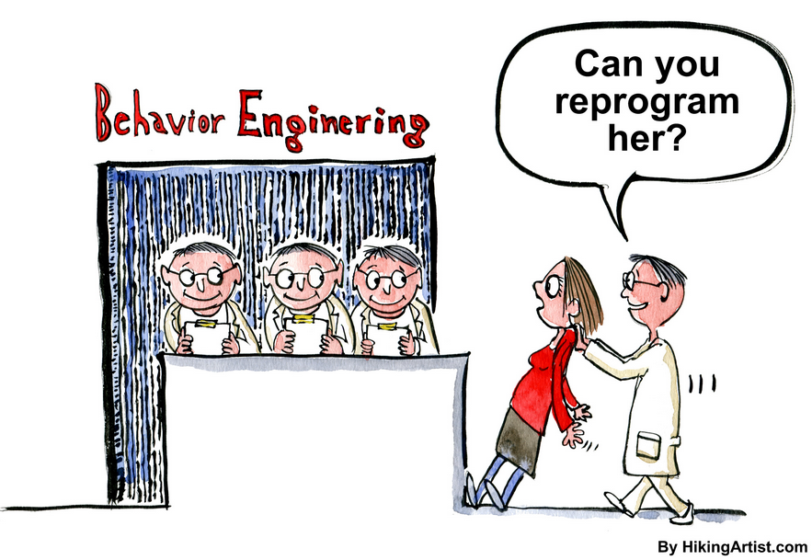
Behavioral Challenges
Changing behavior
  Raise awareness
  Increase motivation
  Decrease hurdles
  Right metrics

Slide 17

Behavioral Challenges
Circumventing behavior
  Plug-in technology
  Enforce behaviors
  Proactive vs. reactive
  Automated reporting

Slide 18
CFAM consideration in existing policies, framework, and regulations

Slide 19
CFAM and DoD Policy: Quick Summary
DoD guidance focused primarily on DoD’s IT and PIT systems NOT industry’s
  DoD does NOT intend Program Protection Plan to address CFAM issues
  DoD moving to RMF - System Security Plans appear to be required only for classified information systems
DFARS 204.73 addresses “Covered Defense Information”
  See NARA Registry entries for “Controlled Technical Information” AND “Proprietary Business Information-Manufacturer”.
  NIST SP 800-171 controls or suitable alternatives required
  Flowdown of CDI protection requirements to subs established by next higher tier
  DoD does not plan to create an industry cybersecurity certification regime
  FedRAMP “Moderate” certification required for cloud providers
NIST products contain lots of good info, but effective application requires time and expertise S&MEs often lack
DFARS 252.204-7012 breach reporting requirements refined
  All reports to DoD within 72 hours of incident discovery
  Subs relay incident report number to relevant primes

Slide 20
Special Considerations for S&MEs

Slide 21
Cybersecurity: Most Manufacturers are Small & Medium Enterprises (S&MEs)
U.S. Manufacturers: 251,901 Total
  Often lack cybersecurity knowledge and resources
  Most have no full time cybersecurity staff
Believe they are not targets, so they focus on perimeter defense for IT network
Many lack a business case for investing in OT cybersecurity
S&MEs are critical to manufacturing sector and are most vulnerable

Slide 22

DFARS: Small and Mid-Size Enterprises (S&MEs)
  Protecting controlled defense information (CDI) is greatest challenge for S&MEs – giving our adversaries soft entry points
  New DFARS require all contractors to protect information and the networks . . .
  But for SM&Es, these new regulations are largely unfunded mandates that impact their competitiveness
Absent incentives to assist DFARS and NIST implementation, DoD may find that fewer companies will be eligible suppliers for defense systems

Slide 23
Existing and emerging technology

Slide 24
Selected
R&D Recommendations
Agile and flexible threat deterrent system
Data protection, design and encryption technology
Enterprise architecture and new technology concepts
Hybrid cloud deployment
Artificial intelligence, augmented reality
Notes:
Additional R&D Recommendations
Security architectures addressing resiliency and survivability of systems under attack
Encryption in near-real time
Detection methods based on inherent physical properties of the manufactured part that can be rapidly and accurately measured and are not easy to falsely replicate
Better understanding the trade space between physical testing/simulation and virtual simulation
Advanced data governance technologies
Other Recommendations
Promote an overall systems perspective to drive manufacturers toward a robust security platform vs. any one tool.
Recognize and prioritize security as a critical design factor for both individual devices as well as for smart manufacturing systems
Better integrate cybersecurity into engineering, computer science, and management curriculum to increase awareness and mutual understanding of cyber-physical challenges and solutions across relevant disciplines and provide a skilled workforce capable of implementing smart manufacturing infrastructure
Develop common standards to protect data integrity
Update DFARS to include minimum acceptable provisions for cloud service contracts and service level agreements impacting defense suppliers

Slide 25
Questions?

Slide 26
Backup

Slide 27
Subjects addressed at DoD Cybersecurity Challenges Industry Day, 23 June 2017
Applicable cybersecurity policy and guidance
… but wait, there’s more

Slide 28
Subjects addressed at DoD Cybersecurity Challenges Industry Day, 23 June 2017
Applicable acquisition policy, DoD Instructions and Manuals, and two recently-instituted DFARS clauses
Interestingly, guidance on the Program Protection Plan does not explicitly address protection of critical manufacturing data
… and more

Slide 29
Subjects addressed at DoD Cybersecurity Challenges Industry Day, 23 June 2017
Policy governing network penetration and breach reporting
… and more

Slide 30
Subjects addressed at DoD Cybersecurity Challenges Industry Day, 23 June 2017
NIST SP 800-171 r1, contains controls contractors must implement by 31 Dec 2017
Contains references to 14 other documents including two FIPS pubs and 3 major NIST SP’s
  800-53 r4 (r5 in public comment period and refers to 32 references)
  800-60 vols. 1 and 2
… and more

Slide 31
Subjects addressed at DoD Cybersecurity Challenges Industry Day, 23 June 2017
Policy on use of cloud computing
… and more

Slide 32
… and more

Slide 33
… are we there yet?

Slide 34
… are we there yet?

