Slide 1
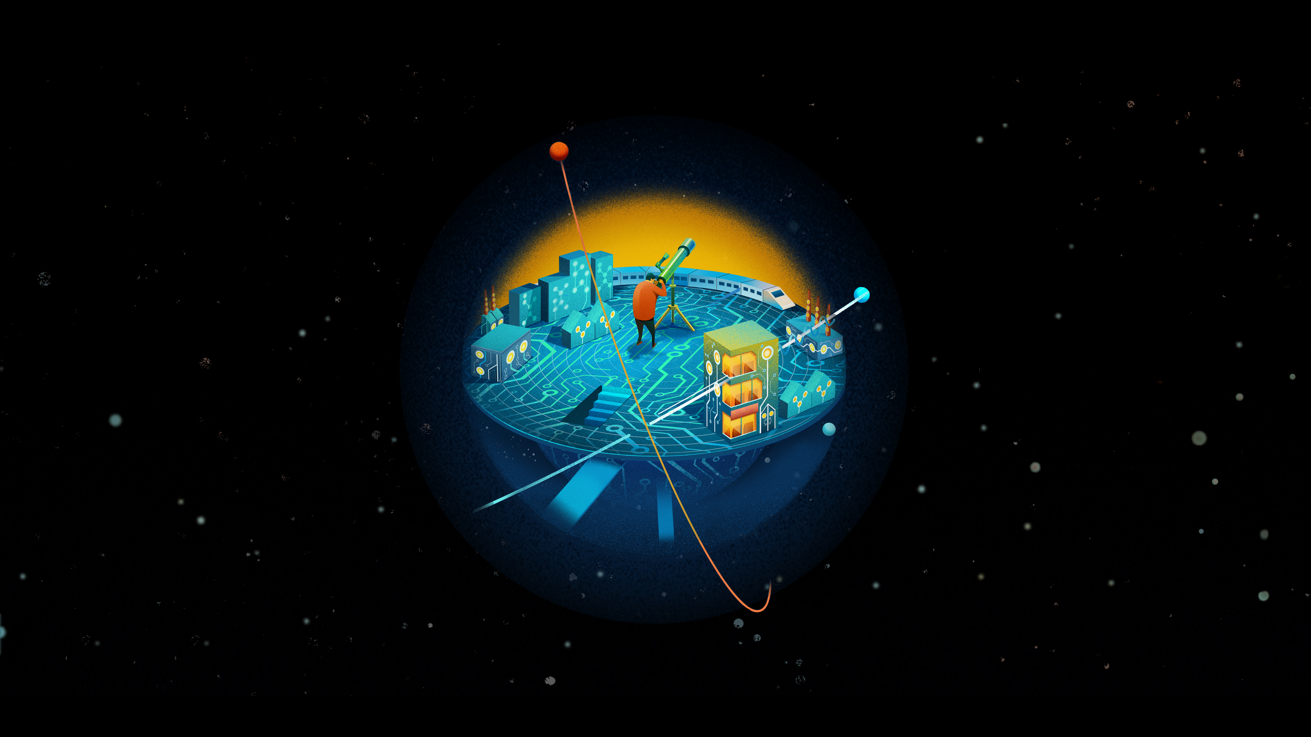
Tech Trends 2017
The kinetic enterprise
Mark White| Innovation Office, Chief Technologist
@MarkAtDeloitte
Deloitte Consulting LLP

Slide 2
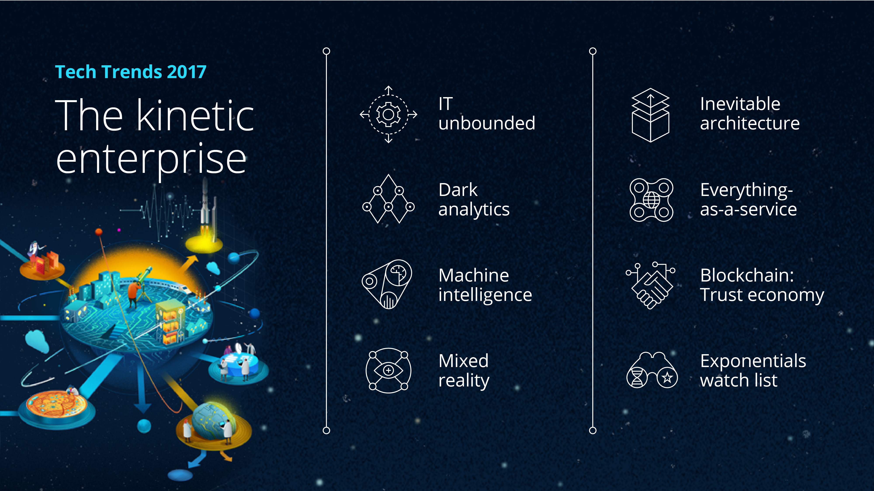

Slide 3



IT’s transformation into an open, agile, and cross-disciplinary
operating and delivery model

Slide 4



Shining a light on video, audio, images, the deep web,
and other sources of untapped data

Slide 5



Machine learning, bots, and robotics solutions augmenting
and automating humans

Slide 6



Augmented reality, virtual reality, and the Internet of Things
go to work

Slide 7



Modernizing infrastructure & platforms through containerization,
standards, and autonomics

Slide 8



The business imperative for reinventing core systems

Slide 9



The protocol for digital assets, identities, and smart contracts

Slide 10



Today’s science fiction, tomorrow’s reality: synthetic bio, nanotech, quantum computing, and energy storage

