Slide 1
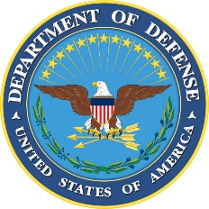
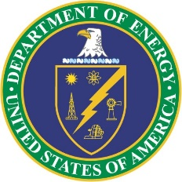
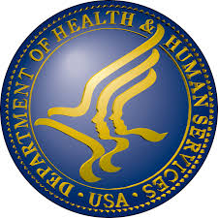
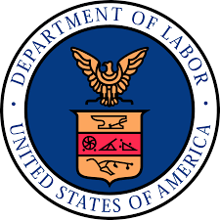


2017 Annual Conference
National Council for Advanced Manufacturing
Mike Molnar
Advanced Manufacturing National Program Office
An interagency team building partnerships
with U.S. Industry and Academia

Slide 2
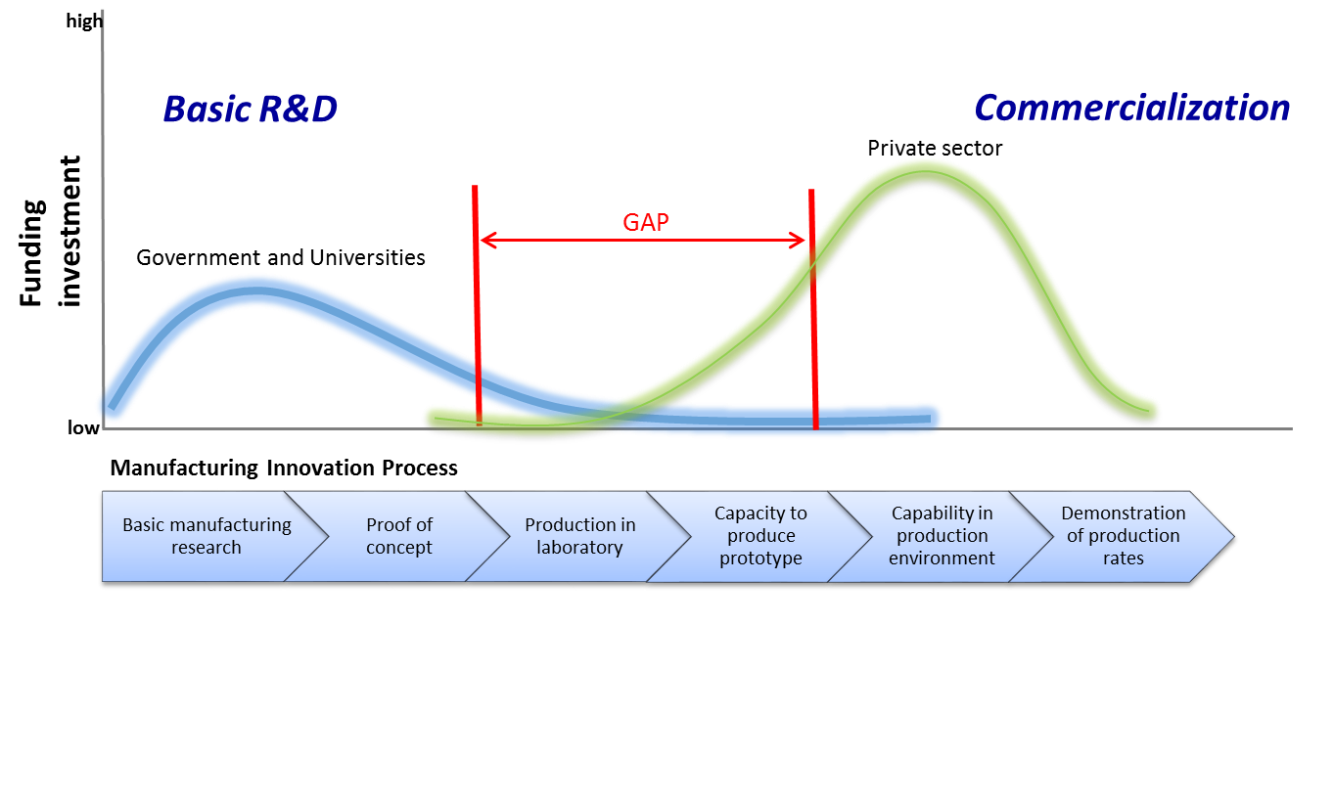
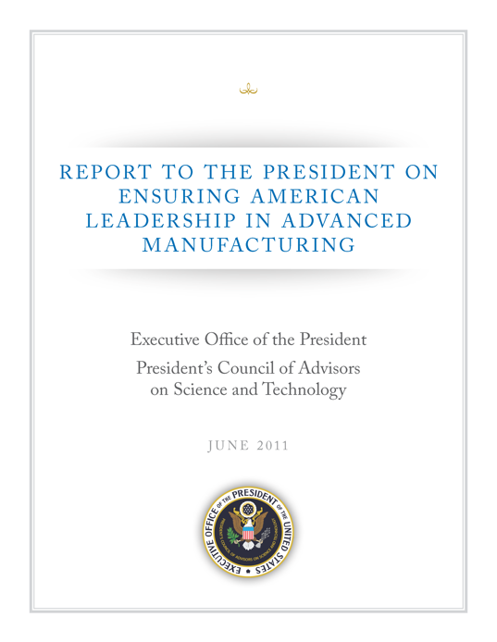
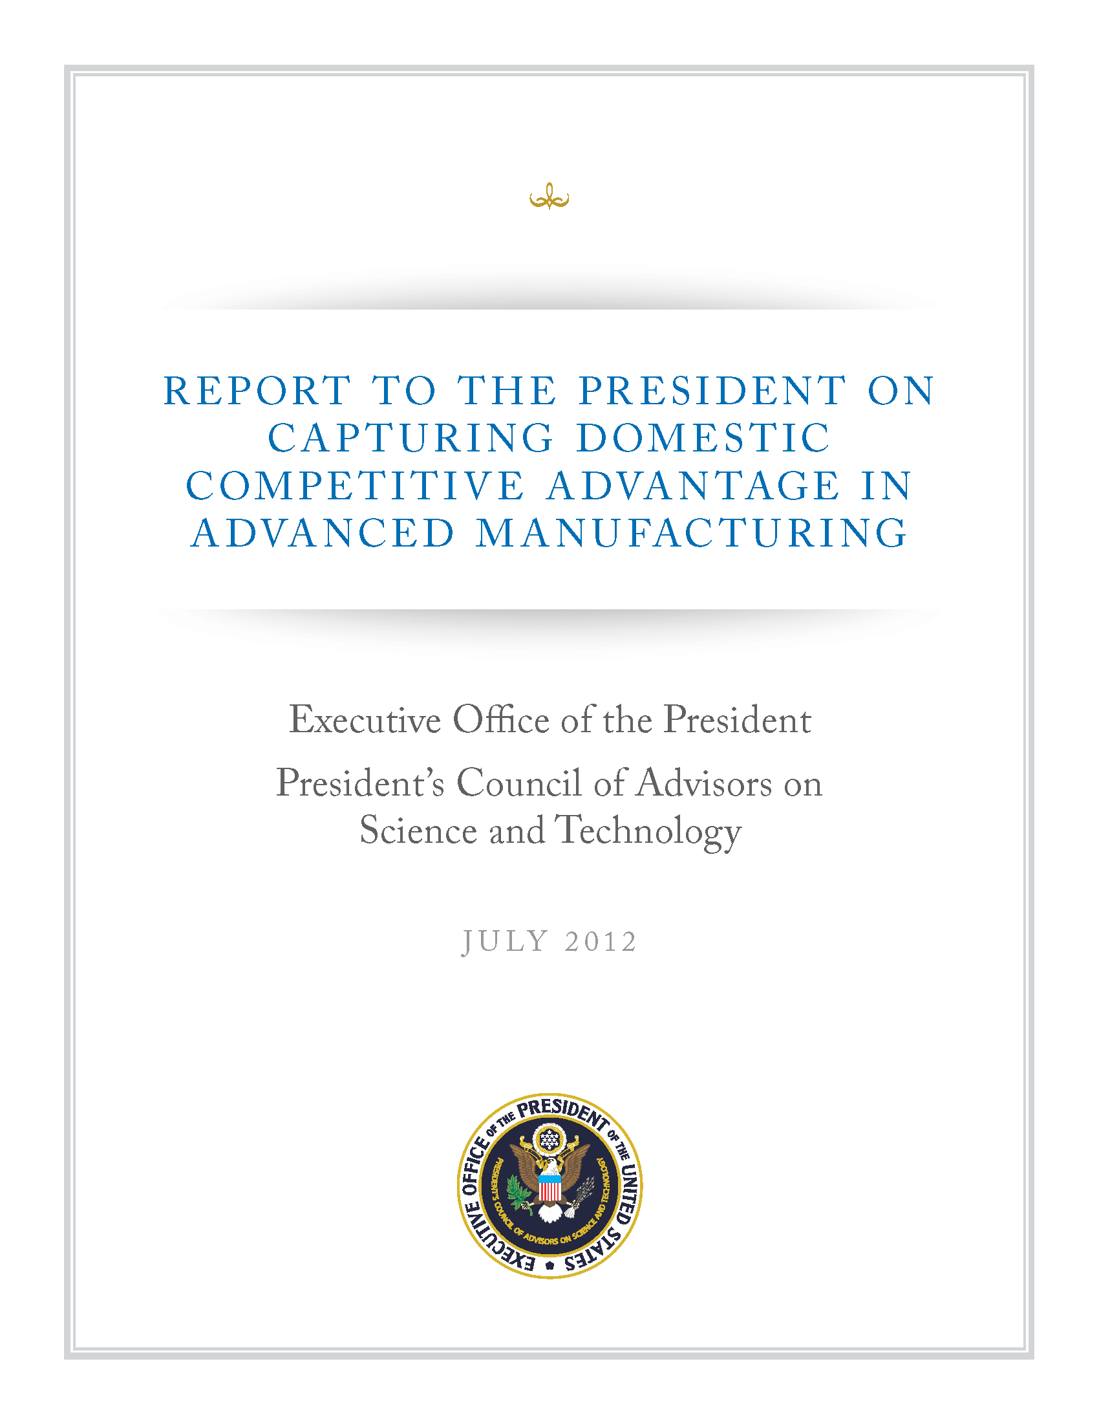
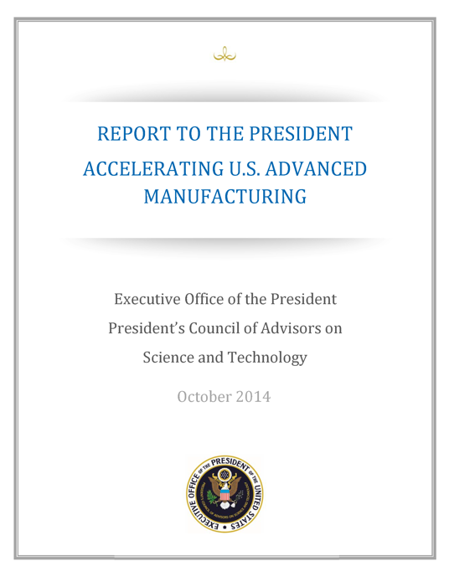
Manufacturing USA: a National need
President’s Council of Advisors on Science and Technology
Market Failure in
Pre-Competitive Applied Manufacturing R&D
National Network for Manufacturing Innovation creates the space for industry and academia to work on industry-relevant problems
Addresses the market failure of industry underinvestment in “pre-competitive”
applied R&D
Focuses on “de-risking” new technologies and materials to scale-up for U.S. manufacturers

Slide 3
Manufacturing USA Strategic Goals
Mission
Vision
Program Goals
U.S. global leadership in advanced manufacturing
Connecting people, ideas, and technology to solve industry-relevant advanced manufacturing challenges, thereby enhancing industrial competitiveness and economic growth and strengthening our national security
Competitiveness
Technology Advancement | Workforce Development | Sustainability

Slide 4
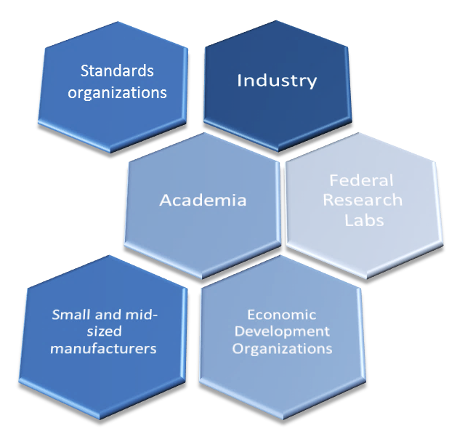
Manufacturing Institute Framework
Applied Research + Education/Workforce Skills = Development of Future “Manufacturing Hubs”
Standards organizations
Federal funding is the catalyst to bring stakeholders into shared space to de-risk innovation.
Focus is on industry-relevant problems impacting commercial production, MRL 4-7.
Institutes must be self-sustaining after federal startup investment ends.
Workforce training and development is an essential component in institute focus.
Federal startup investment: minimum $70M/institute over 5 years
Institute Consortium owners must have minimum 1:1 co-investment
Notes:
If you read the design report the executive summary highlights that there are TWO principal missions for each institute, equally important.
Applied Research – this is to “de-risk” and speed up ideas and inventions into solutions that U.S. manufacturers can use in their products and processes.
Education and Workforce – U.S. manufacturers continue to face a critical shortage of skilled workers. Each institute has a role to play for education and workforce skills related to their chartered topic. In this contest Institutes are not competing with universities and community colleges, but partnering with them on advancing the knowledge needed.
Together, the goal is to catalyze “manufacturing hubs” – building the supply chain and capabilities so that the U.S. leads in each respective area.
(add in any amplifying message about workforce, supply chains)

Slide 5
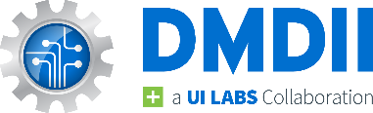
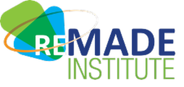
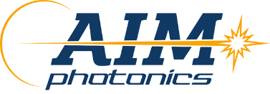
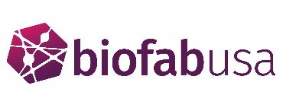
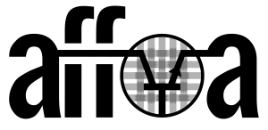


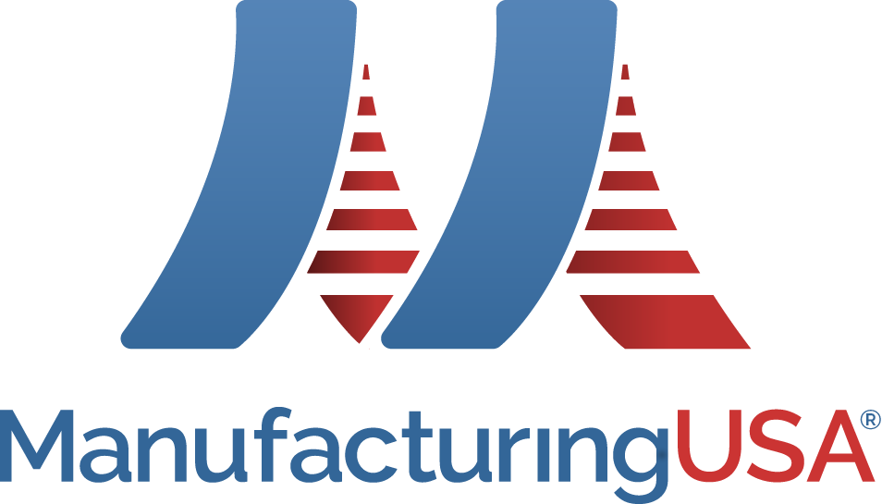
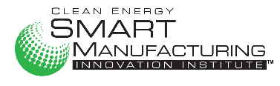
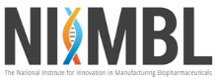
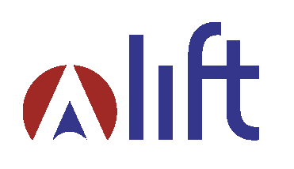
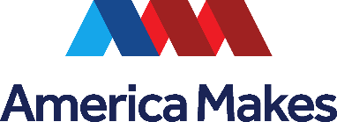
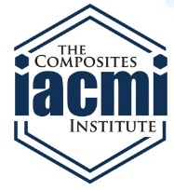
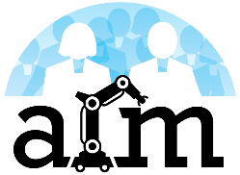
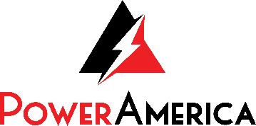
Manufacturing USA Today
Regional Hubs with National Impact
Digital Manufacturing & Design
Chicago, IL
Sustainable Manufacturing
Rochester, NY
Integrated Photonics
Albany, NY
Rochester, NY
Regenerative Manufacturing
Manchester, NH
Advanced Fibers and Textiles
Cambridge MA
Flexible Hybrid Electronics
San Jose, CA
Modular Chemical Process Intensification
New York, NY
Smart Sensors and Digital Process Control
Los Angeles, CA
Bio-pharmaceutical Manufacturing
Newark, DE
Lightweight Metals
Detroit, MI
Additive Manufacturing
Youngstown, OH
Advanced
Composites
Knoxville, TN
Advanced Robotics
Pittsburgh, PA
Wide Bandgap Semiconductors
Raleigh, NC
Notes:
Version:May 5, 2017

Slide 6
Measuring Performance
Institute Metric Category
Specific Metric
Units of measure
Number of partner organizations with institute membership agreement
1)
Total number of memberships
Impact to U.S. Innovation Ecosystem
Large manufacturers
Diversity of members
Small manufacturers
Academia
2)
Other entities
Financial Leverage
Total co-investment
Cost share expended
Number and value of active R&D projects
Number of projects completed, started and spanning FY 2016
3)
Technology Advancement
Total institute expenditures
Percentage of key project technical objectives met
Percentage of key milestones met
Number of students participating in institute projects, internships, and training
STEM activities
4)
Development of an Advanced Manufacturing Workforce
Number of workers completing an institute-led certificate, apprenticeship or training program
Educator/trainer engagement
Number of teachers or trainers participating in institute-led training

Slide 7
1) Impact to U.S. Innovation Ecosystem
Manufacturing USA Institutes Have 830 Members – 66 % are Manufacturers
66 % of manufacturers (341) were small manufacturers.
Other participants included:
  177 universities, community colleges, and other academic institutions
  105 other entities, including federal, state, and local government agencies, federal laboratories, and not-for-profit organizations.

Slide 8
2) Financial Leverage
FY 2016 matching was nearly 2 to 1
Of $333,808,455 in total institute expenditures
  66 % of Institute Came from Non-Federal Matching Funds
  34 % came from non-program matching expenditures
Expenditures funded all aspects of institute operation (e.g. technology advancement projects, education and workforce training efforts, and capital equipment)

Slide 9
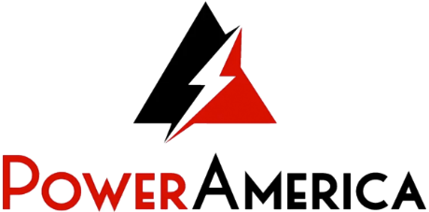
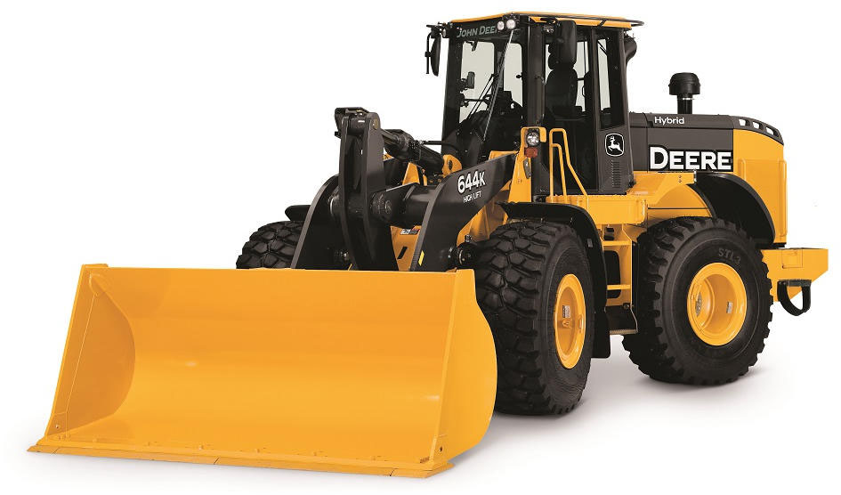
3) Technology Advancement: Innovation Leads to U.S. Jobs
FY 2016: 191 active research and development projects at institutes. Example Project at PowerAmerica
In under a year, researchers from John Deere and the Department of Energy National Renewable Energy Laboratory developed a prototype high power inverter for hybrid motors in heavy duty construction vehicles and trucks.
Higher efficiency and lower heat-related breakdowns compared with traditional transformer-based inverters.
Deere plans to hire American production workers in Fargo, ND to manufacture and sell inverters starting in 2019.
“Through our collaboration with PowerAmerica, we believe our silicon carbide technology work has been advanced by five years.” — Brij Singh, John Deere

Slide 10
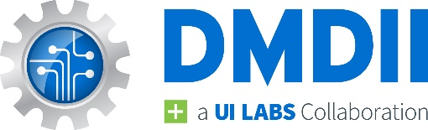
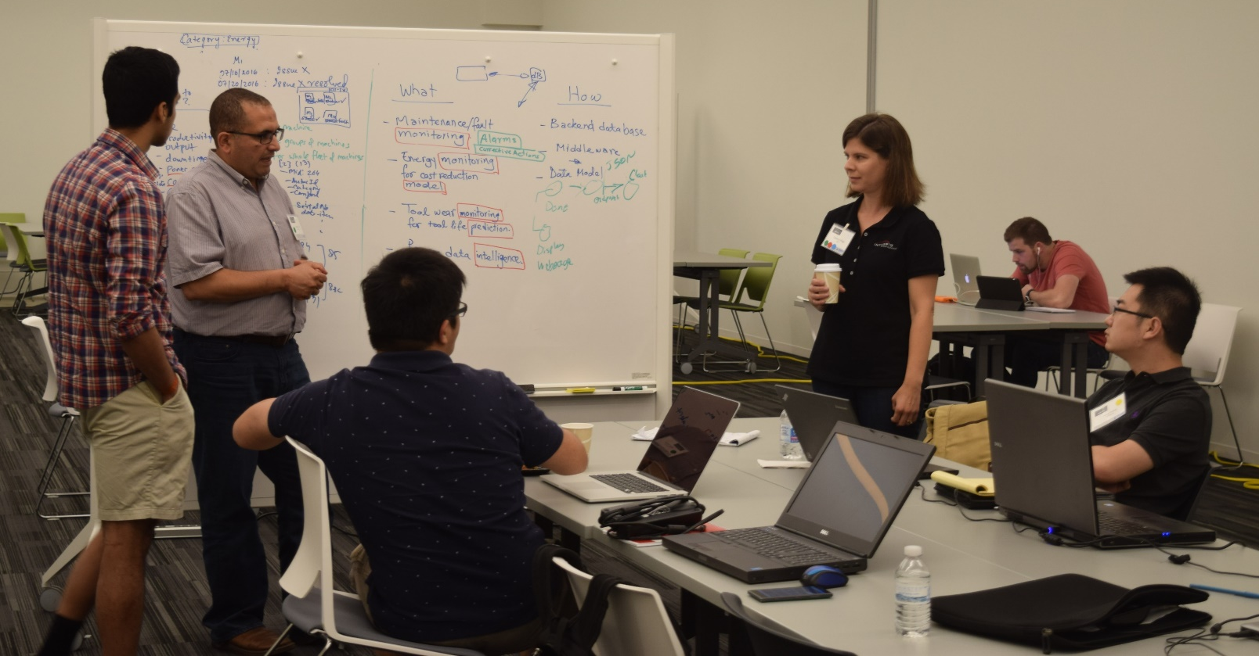
3) Technology Advancement: Collaboration Improves Efficiency
Example Project at DMDII
Digital Manufacturing Commons Hackathon
  Participants developed and tested Digital Manufacturing Commons apps using 4.5 years worth of real-world factory floor data from Indiana-based ITAMCO
  ITAMCO benefits from community analysis of their data, suggesting ways to optimize utilization, improve energy usage and manage machine health
“To develop new ideas and remain competitive, we need to break out of our silos - and that’s exactly what we’re able to do by working with DMDII. The DMDII network connects us with people we wouldn’t have been able to access otherwise - from large OEMs to entrepreneurs and hackers,” Joel Neidig, ITAMCO

Slide 11
4) Development of an Advanced Manufacturing Workforce
Nearly 28,000 participated in institute-led workforce programs, including
  23,560 students in institute research and development projects, internships, or training
  3,386 workers completed institute-led certificate, apprenticeship, or training programs
  1,023 teachers and trainers in institute-led training for instructors

Slide 12
4) Workforce: The Role of the Network
The Manufacturing USA Education and Workforce Development team identified common skills needed across advanced manufacturing technologies
They developed a common training model, built around those core competencies
Each institute then adopts, refines, or develops technology-specific modules to meet their industry’s needs.
The model evolves as institutes improve and share common materials across the network

Slide 13
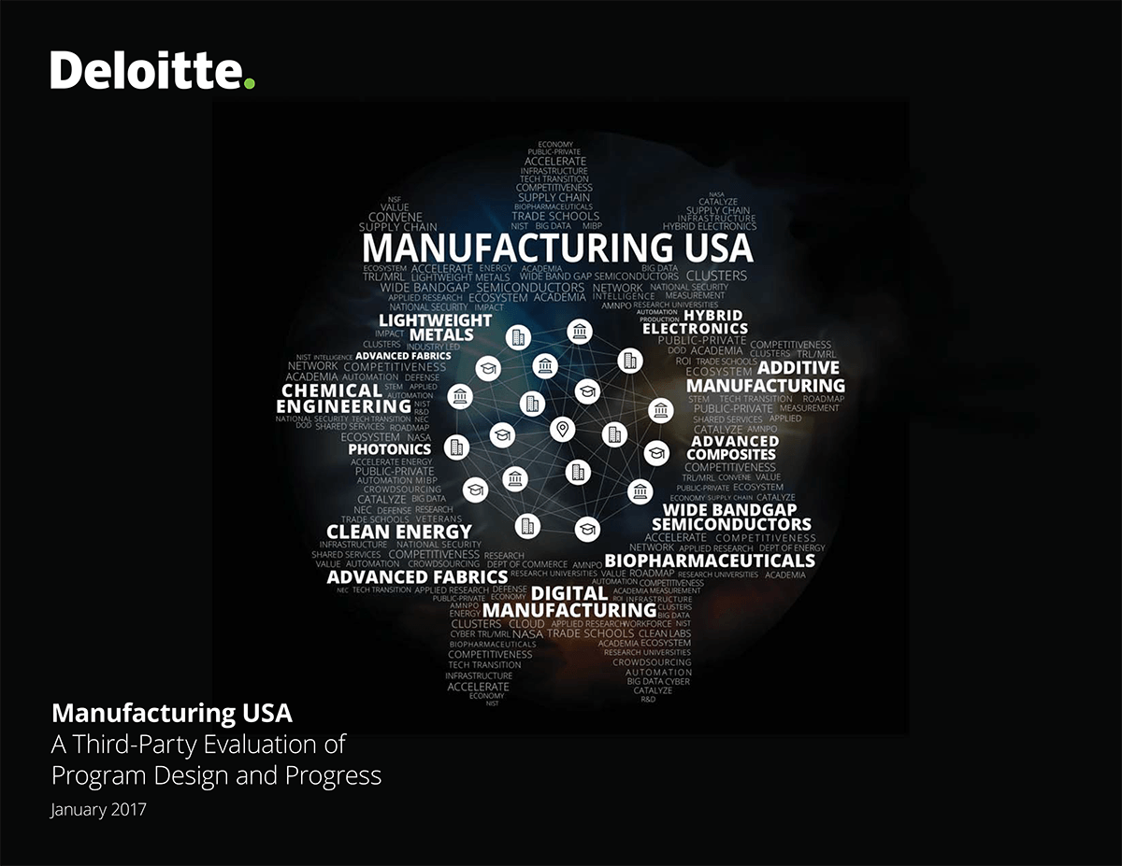
Third Party Assessment Commissioned
Deloitte studied key areas in order to evaluate and assess Manufacturing USA’s national-level impacts, including:
Program Theory and Structure
  Is the program doing the right things?
  Is the program meeting objectives / impacts?
Program progress
  How is the program performing, achieving its objectives, and creating impact?
  Qualitatively, what are case studies / examples of impact?
  Quantitatively, what does the data tell us about impact?
Recommendations
  What can be improved?
Copyright © 2016 Deloitte Consulting LLP. All rights reserved. Business Proprietary .

Slide 14
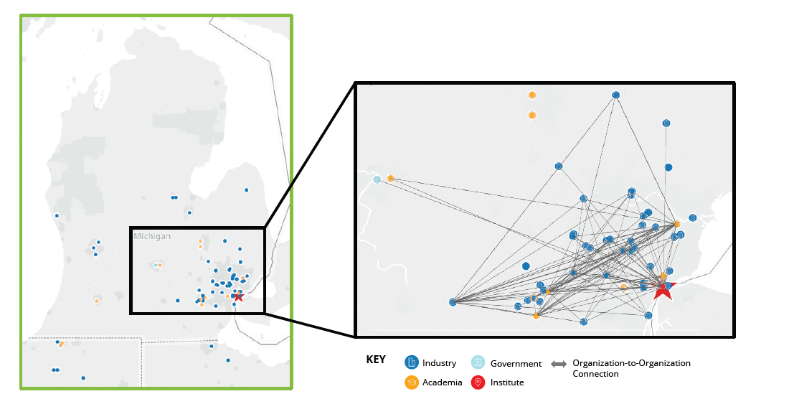
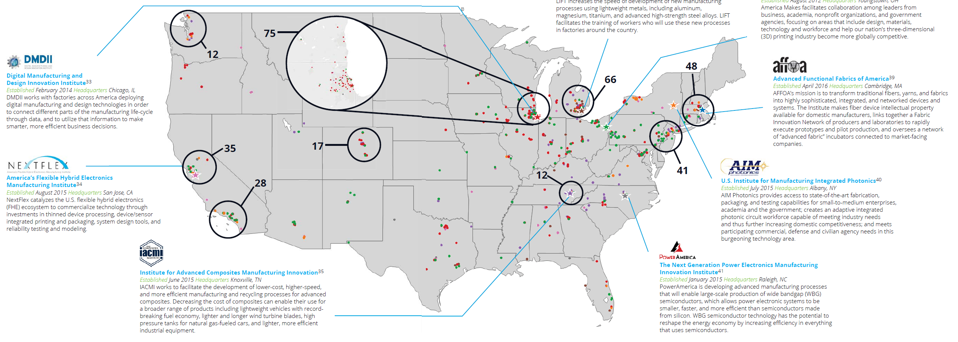
Formation of Regional Clusters
Manufacturing USA shows signs of strengthening regional economic clusters
Inset: Advanced Manufacturing Ecosystem in Detroit, MI – Anchored by the LIFT Institute
63 organizations from across seven Institutes have generated 125 connections
Copyright © 2016 Deloitte Consulting LLP. All rights reserved. Business Proprietary .

Slide 15
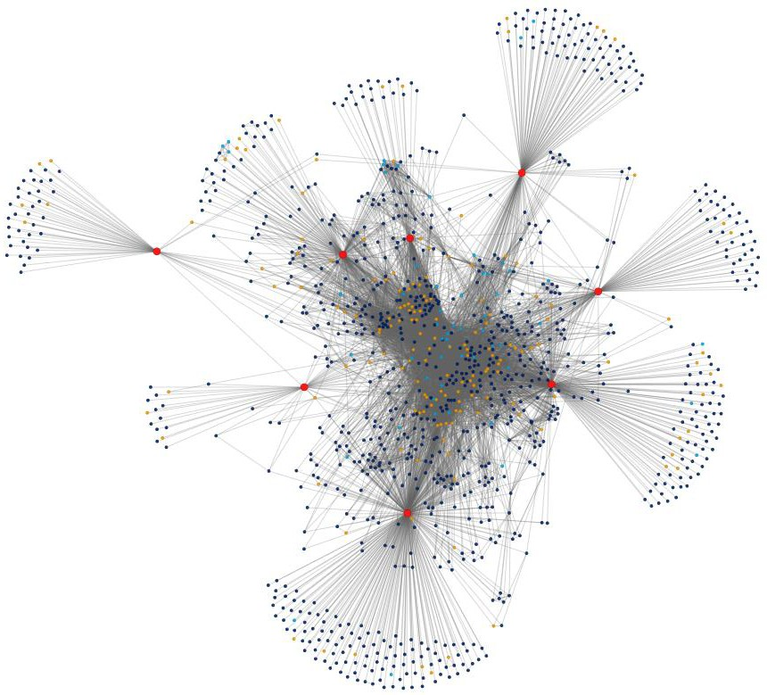
The Power of Connections
Manufacturing USA Institutes address the “valley of death” through seed funding and by bringing together stakeholders to commercialize advanced technologies
AIM
Photonics
9,424
Relationships between organizations
Together, the Institutes’ convene nearly 1,200 organizations in an inter-industry
network comprised of 9,000+ organization relationships
NextFlex
IACMI
1,174
Organizations involved with the program
AFFOA
753
Organizations with formal
membership
LIFT
Power America
203
Organizations have relationships with multiple institutes
America Makes
Some organizations in the outer “fans” take advantage of the convening power of the Institutes to keep abreast of developments in their technology area and network with their peers.
120
Organizations are members of more than one institute
DMDII
Organizations in the center of the network are highly involved in projects across multiple institutes and help steer the direction of the network.
Copyright © 2016 Deloitte Consulting LLP. All rights reserved. Business Proprietary .

Slide 16
Collaboration Multiplier Effect
Institutes decrease the cost of experimentation for their members by providing access to cost prohibitive equipment and pooling R&D dollars.
  Institutes are demonstrating the potential to deliver 5x leveraged value for members
  Institutes give members access to not only government funding and partner funding on projects but also broader IP portfolios and R&D
PowerAmerica Institute member facility.
DMDII Facility in Chicago, Illinois

Slide 17
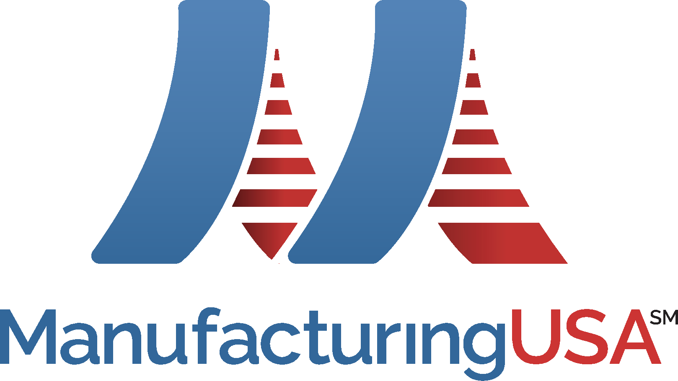
Third Party Assessment Findings & Program Progress
Key Findings - Manufacturing USA Spurs R&D Innovation
The Program is a highly effective ecosystem convener
Institutes are demonstrating the potential to deliver 5x leveraged value for members
Institutes are successfully planning for sustainability independent of U.S. government influence
Progress to Date
As of today, 14 institutes launched - $1 billon federal investment matched by over $2 billion non-federal
Of Eight active institutes: 1,300 members, over 240 technology development projects.
  Members include two-thirds of Fortune 50 U.S. manufacturers
  8 out of the 10 top-ranked research and engineering universities.

Slide 18
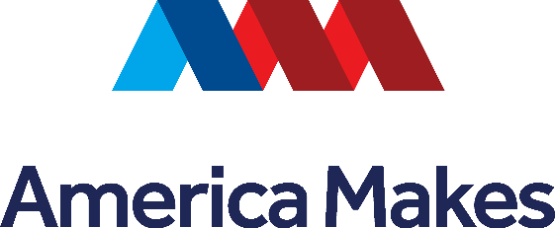
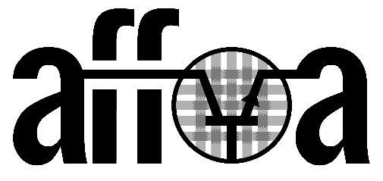
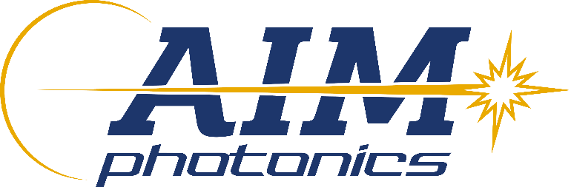
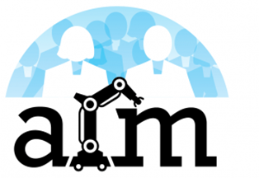
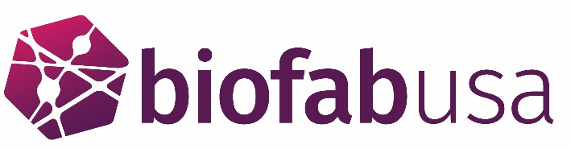
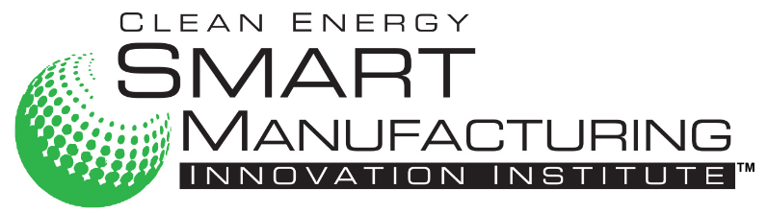

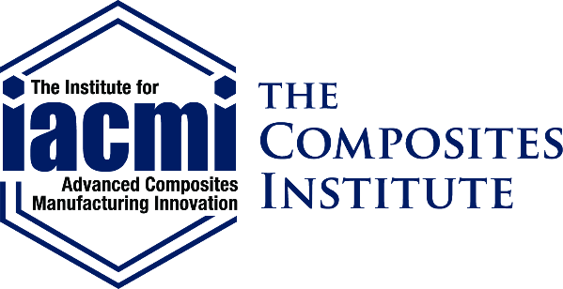
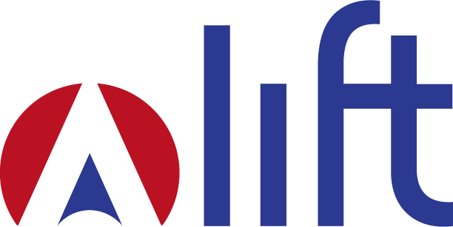
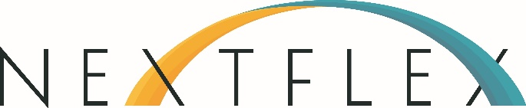
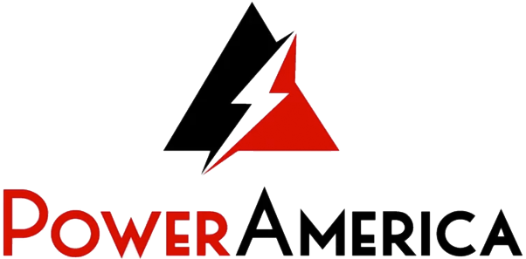
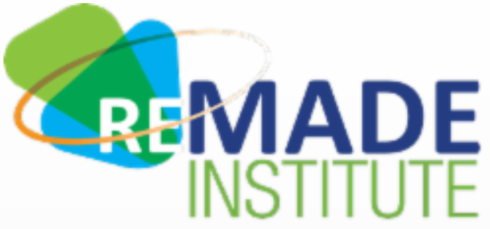
Thank you!

