Slide 1
U.S. Army
Field Studies Program
Washington D.C. Field Trip

Slide 2
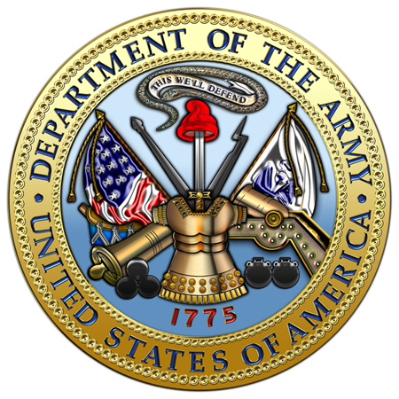
Point of Contact
Ensure you have your Escort’s number
Trip Director:CPT Matthew Cox 334-406-2146
Paula Everett
Office of the Army G-2
Army Foreign Liaison
Civ: #703-692-1458
Eric Endries
Field Studies Program Manager
SATFA, TRADOC G-3/5/7
Civ: #757-501-5042

Slide 3
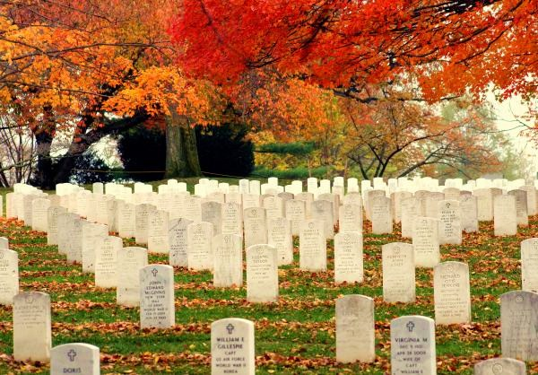
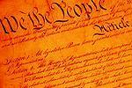
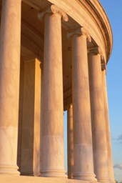
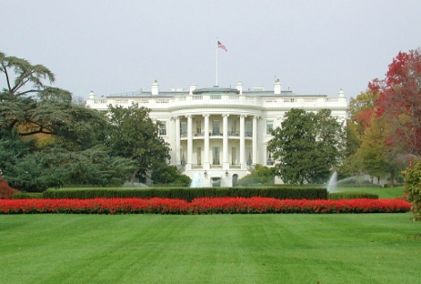
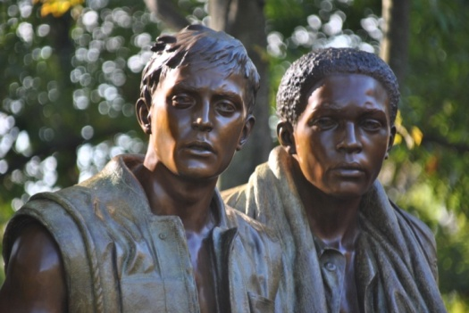
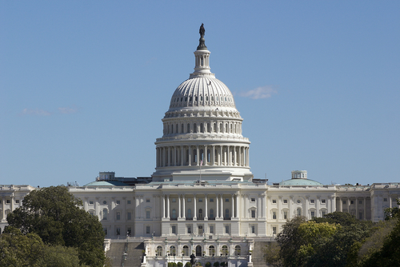
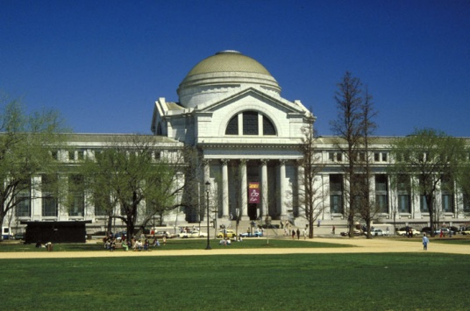
Washington D.C.
Field Trip

Slide 4
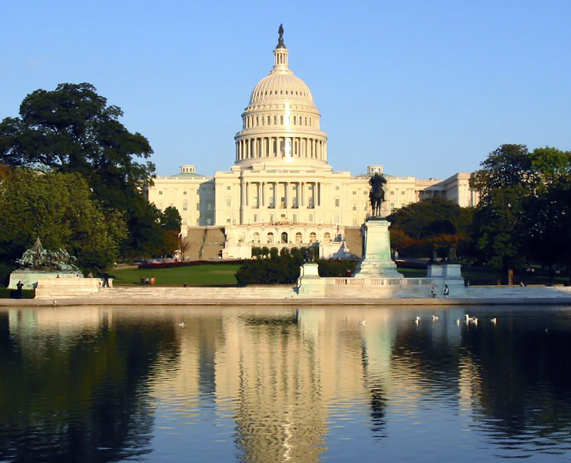
Washington D.C. Field Trip
Tours per year
35+ countries from 13x Locations
12x Branch Captain Career Courses
2x CGSC, Fort Leavenworth, KS
1x CGSC, WHINSEC
1x SMA, Fort Bliss, TX
See itinerary for date & time
The Pentagon
Reception at Fort Myer
Holocaust Memorial
Capitol Hill
Washington Monument
Jefferson Memorial
Lincoln Memorial
FDR Memorial
MLK Memorial
WWI Memorial
WWII Memorial
Korean War Memorial
Vietnam War Memorial
Arlington National Cemetery
Marine Corps War Memorial
Smithsonian Institution

Slide 5
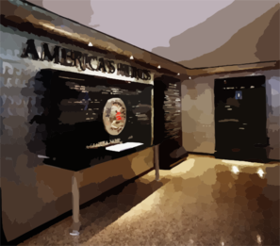
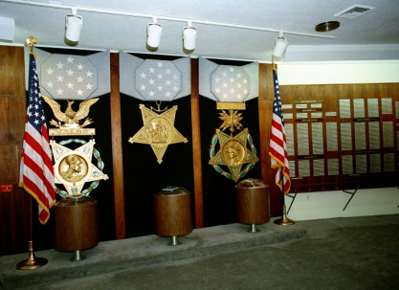
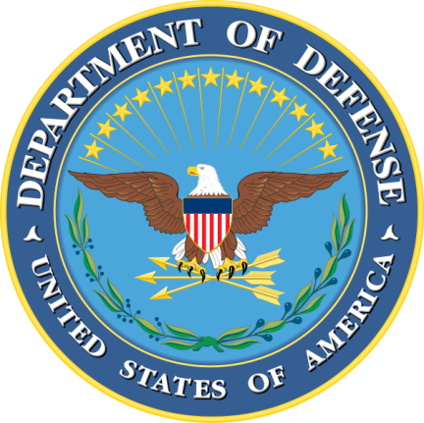
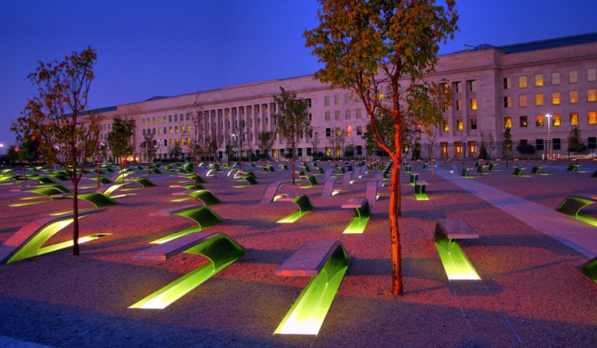
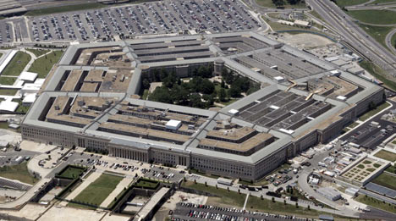
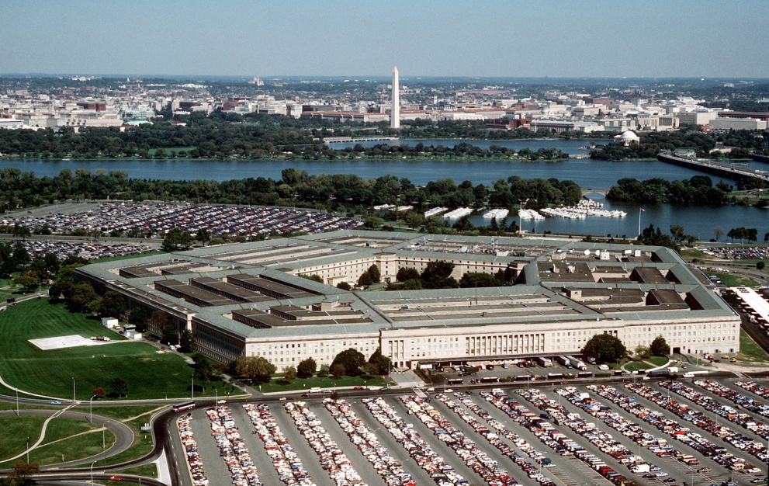
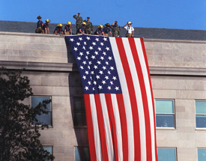
The Pentagon
Tour 911 Memorial
Welcome Remarks
Breakout Discussions
with AO Desk Officers
Pentagon Tour
The Pentagon is:
* a building
* an institution
* a symbol

Slide 6
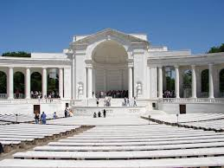
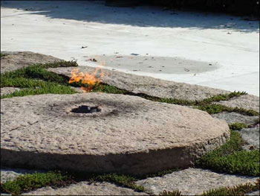
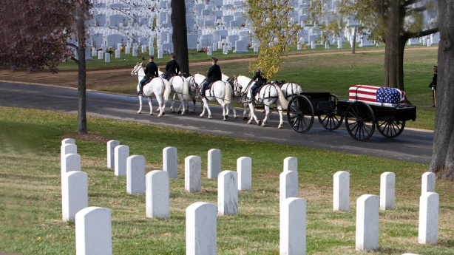
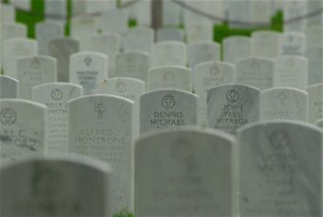
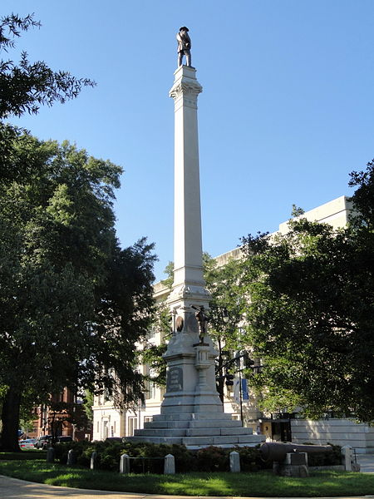
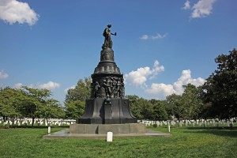
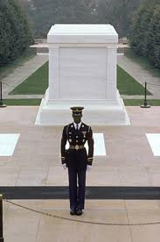
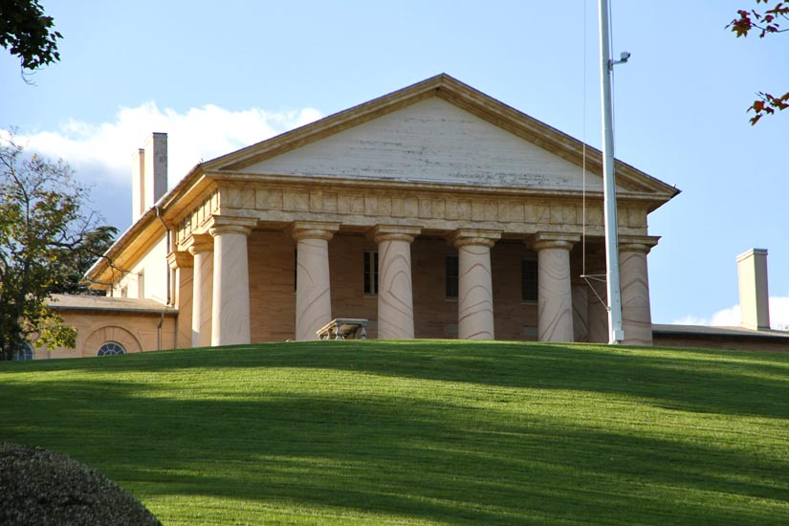
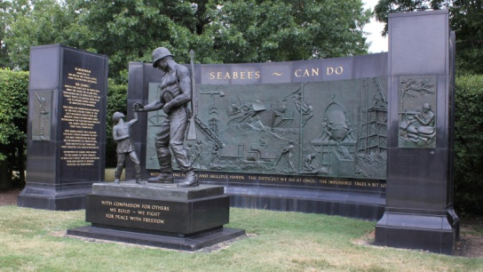
Arlington National Cemetery
…our Nation’s most hallowed ground
Arlington National Cemetery is the final resting place for more than 400,000 active duty service members, veterans and their families.

Slide 7
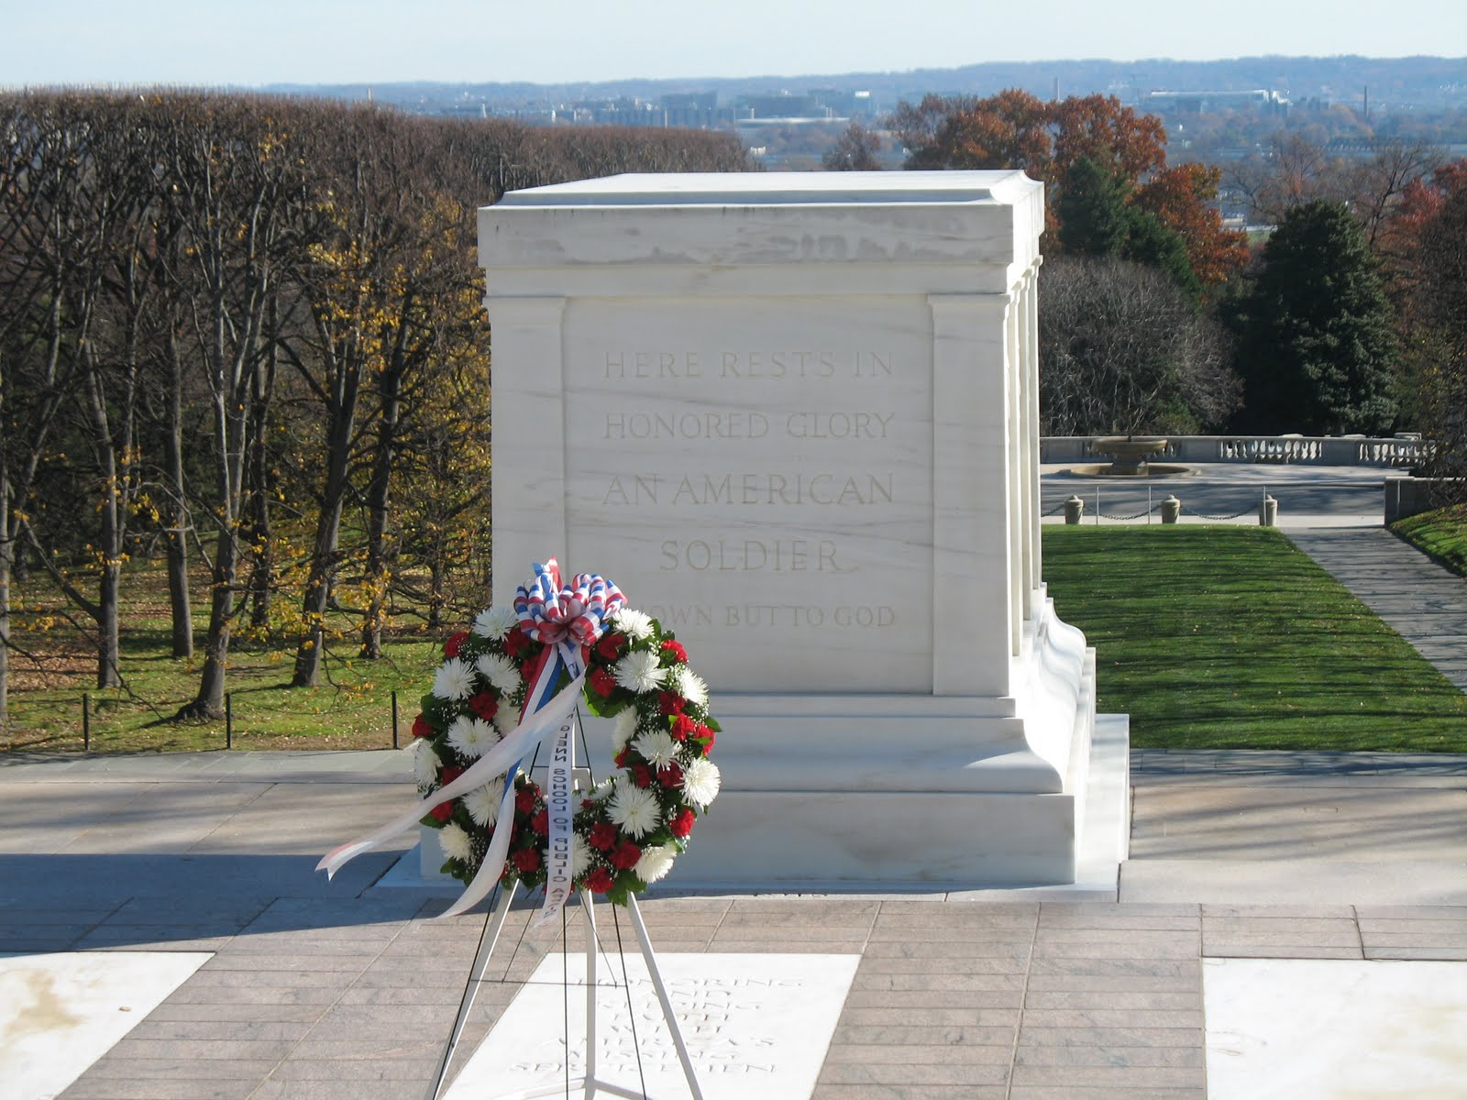
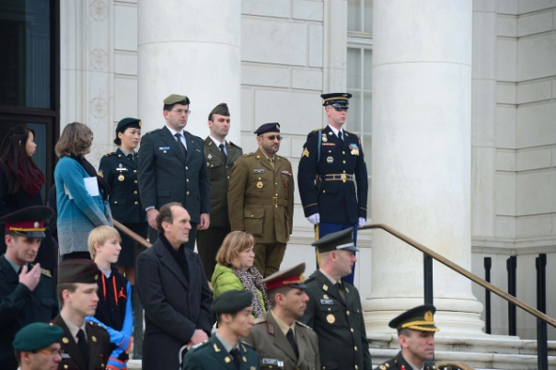
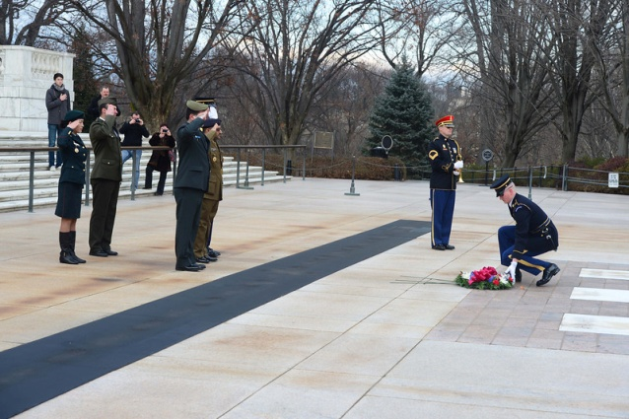
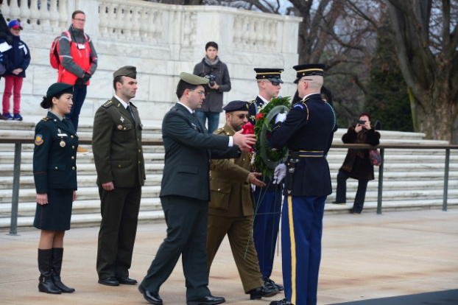
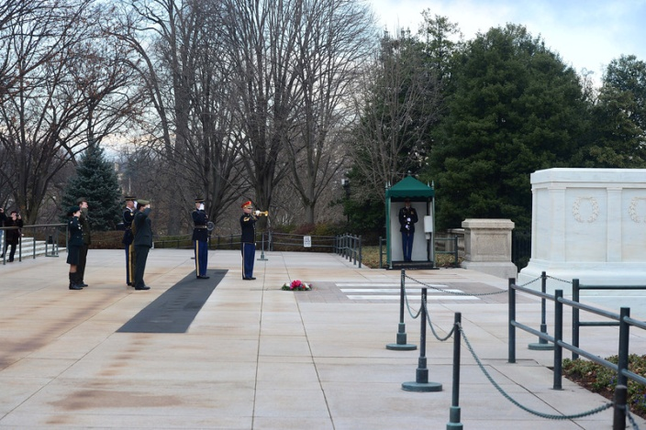
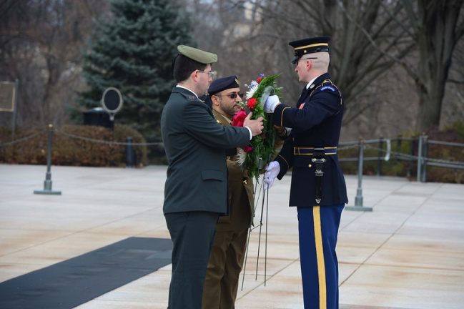
Arlington National Cemetery
…wreath laying ceremony

Slide 8
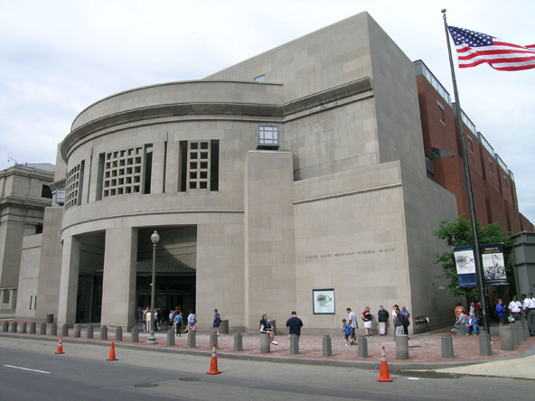
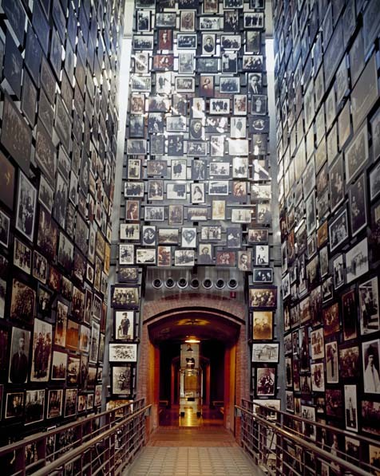
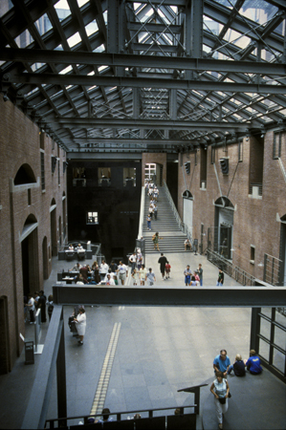
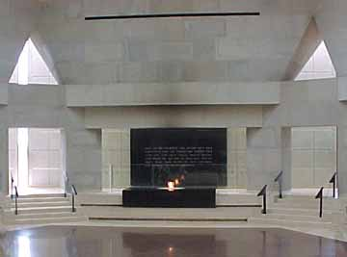
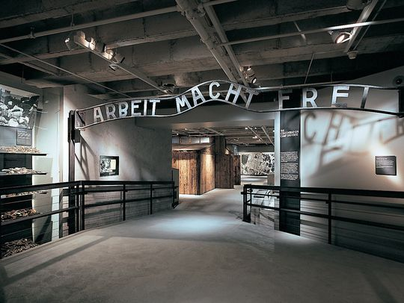
United States Holocaust Memorial Museum
Guided orientation
Tour of museum
Working Group/Discussion Lunch
FAMILY MEMBERs will not participate
Learning goals for the group are:
Presentation of A Good Man in Hell
13 min. film about Gen. Dallaire in Rwanda with discussion of
the warning signs of genocide in Rwanda
Understanding of the definition of genocide and that genocide is preventable
Ability to recognize early warning signs for genocide and mass atrocity
Understanding of the devastating consequences of human rights violations
Awareness of the realm of choices they face as individual military officers

Slide 9
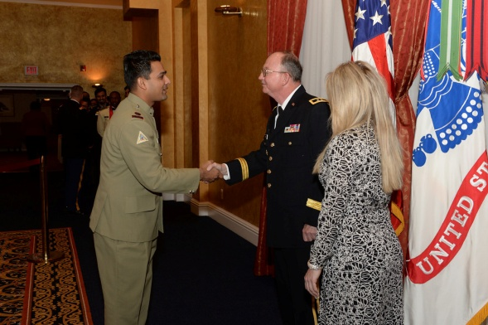
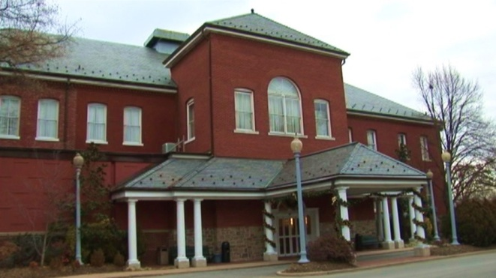
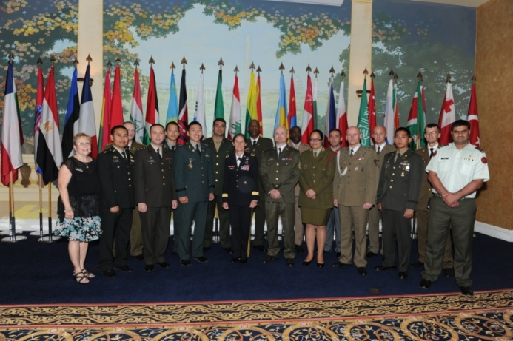
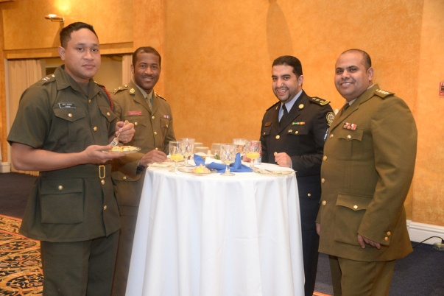
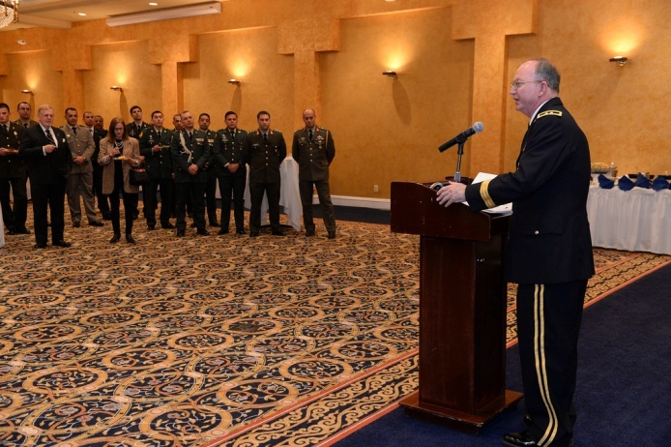
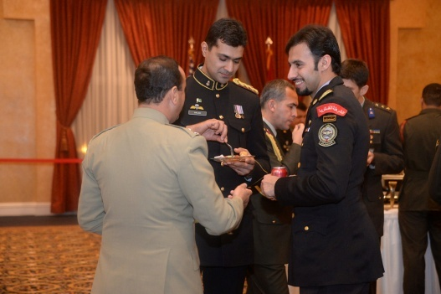
Reception at Fort Myer
Reception at Fort Myer Officers’ Club
Receiving Line and Welcome by Host
Visit with Attachés
Guest Speaker

Slide 10
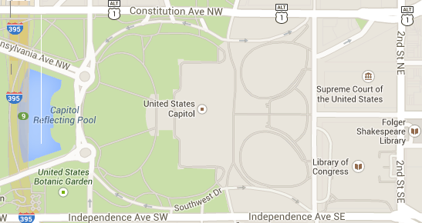
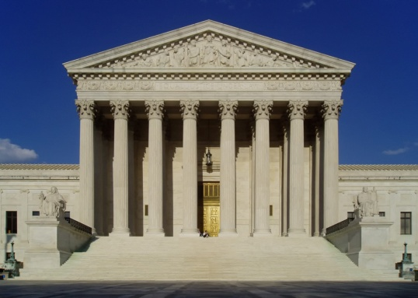
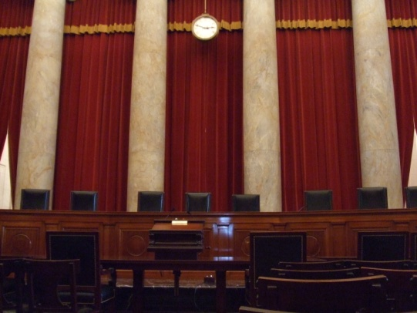
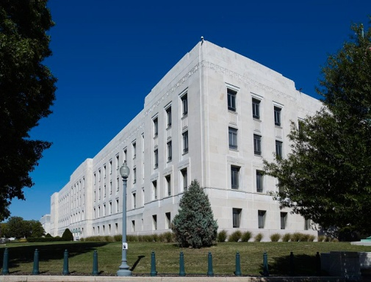
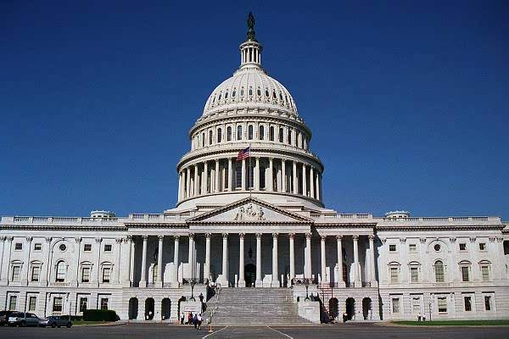
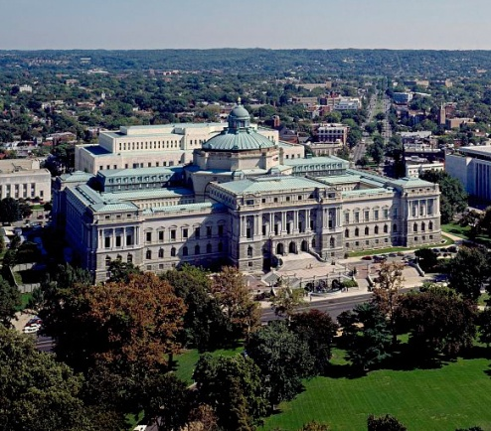
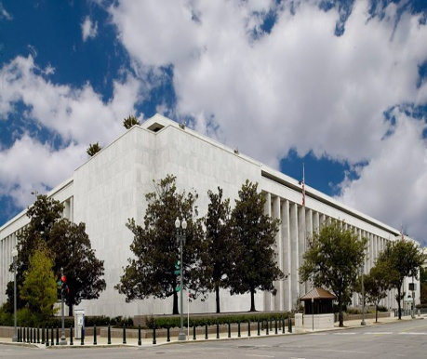
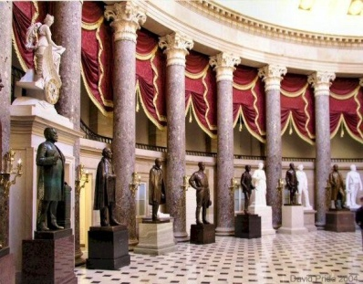
Capitol Hill
The Supreme Court Building is the seat of the Supreme Court of the United States.
The United States Capitol is the meeting place of the United States Congress, the legislature of the U.S. federal government.
The Library of Congress occupies three main buildings on Capitol Hill. Each is named after a President of the United States who was a strong connection with the creation of Congress’s library.
John Adams Building
James Madison Building
Thomas Jefferson Building

Slide 11
Monuments & Memorials
Washington Monument
FDR Memorial
Jefferson Memorial
Lincoln Memorial
MLK Jr. Memorial
Marine Corps War Memorial
Vietnam War Memorial
Korean War Memorial
World War II Memorial
World War I Memorial

Slide 12
Smithsonian Institution
Founded in 1846, the Smithsonian is the world's largest museum and research complex, consisting of 19 museums and galleries, the National Zoological Park, and nine research facilities.
Lincoln’s Hat
Teddy Roosevelt’s Chaps
The original Star
Spangled Banner
George Washington's Continental Army uniform
Watergate Filing Cabinet

Slide 13
Other Possible Museums
National Archives and Records Administration (NARA) is an independent agency of the United States government charged with preserving and documenting government and historical records and with increasing public access to those documents, which comprise the National Archives.
Ford's Theatre is a historic theatre in Washington, D.C., used for various stage performances beginning in the 1860s. It is also the site of the assassination of U.S. President Abraham Lincoln on April 14, 1865.
The National Guard Memorial Museum is a military museum hosted by the National Guard Educational Foundation
Explore the world and all that's in it at the National Geographic Museum.
The International Spy Museum is a privately owned museum dedicated to the tradecraft, history and contemporary role of espionage, featuring the largest collection of international espionage artifacts currently on public display.
The Newseum is an interactive museum of news and journalism.
…and many more

Slide 14
Standards
DCFT is not a vacation
Be on time and in proper attire/uniform (includes family members)
Smoke only in designated areas
Stay with the group
Respect of others views and opinions
Military courtesy
‘Buddy system’
Take time and provide honest feedback on the end-of-tour survey

Slide 15
U.S. Army
Field Studies Program
Washington D.C. Field Trip
Welcome

Slide 16
Back-up Slides

Slide 17
Gratuity
Tipping is NOT mandatory in most of the United States, however it is expected in many circumstances for service.
Why tip? In the USA, a lot of service jobs are paid below minimum wage, because the employees are expected to make up the difference in tips.
TD/Escorts will cover group meals and group transportation tips.
IMS will cover the remaining ‘tip worthy’ services.
Few examples: $1-2 per bag for skycaps, bellhops, doormen, and parking valets if they handle bags; $1 per coat for coatroom attendants; $2-5 per night for housekeeper, $5-10 for concierge service; 15-20% for sit down meal if TD/Escort doesn’t cover; Bartenders: $1 per drink or 15-20% of the total bill.

Slide 18
‘Generic’ DCFT Itinerary
TIME | Monday | Tuesday | Wednesday | Thursday | Friday | Saturday | Sunday
0630-0700 |  | Buffet Breakfast
0700-0800
0800-0900 |  |  | Pentagon Tour | Holocaust Museum | Monument & Memorial Tour | Smithsonian Museum Tours National Gallery of Art Lunch/Dinner Determined by Escorts | Departure
0900-1000
1000-1100
1100-1200
1200-1300 |  |  |  | Extended Luncheon @ Holocaust Museum | Lunch- Union Station
1300-1400 |  |  | Lunch - Ft. Myers O-Club |  | National Archives and Records
1400-1500 |  |  |  | Capitol Tour (Tue. Arrivals Visit Officials after Tour)
1500-1600 |  |  | Arlington Nat'l Cemetery
1600-1700 |  |  |  | Reception Ft. Myers O-Club | Personal Time Dinner arranged by Escorts
1700-1800 |  | TD Meeting | Personal Time Dinner arranged by Escorts
1800-1900
1900-2000
2000-2100
2100-2200
TD Arrives On Mon.
School Arrivals
- MCoE
- WHINSEC
- ACoE
- ICoE
- AMEDD
- USASMA
- MSCoE
- CGSC
CGSC arrives Sunday tied to Gettysburg POI Event
Embassy Visits for some IMS
School Arrivals
- SIGCoE
- FCoE
- JAG
- SCoE
- SSI
Monday Arrivals Visit Elected Officials and tour of respective chamber.
Embassy Visits
for some IMS
1830-2000
Buffet Dinner/Reception @ Regency Hyatt

