Slide 1
A Policy Roadmap to Renew U.S. Manufacturing
September 8, 2017
Washington, D.C.

Slide 2

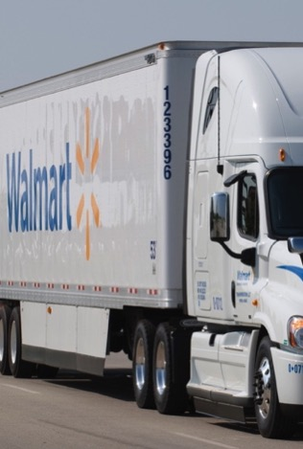
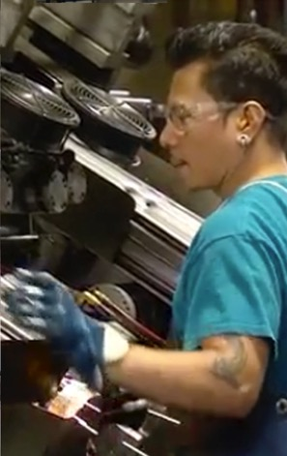

$250B
Customers.
Business.
Community.
#MadeInUSA

Slide 3
Trends Driving Growth of U.S. Manufacturing
U.S. INCREASINGLY COST COMPETITIVE
GREATER PREMIUM ON SHORTENED SUPPLY CHAINS
TRANSFORMATION OF GLOBAL MANUFACTURING
Leading energy input costs
Focus on supply chain cost / risk reduction
Rise of digital manufacturing technologies
Convergence of productivity-adjusted costs
Expectations of greater responsiveness to customers/consumers
Emergence of multi-region supply strategies

Slide 4
Policy Barriers
Workforce
Coordination & Financing
Regulation
Tax & Trade

Slide 5
The First Five Policy Levers
FEDERAL GOV.
LOCAL GOV.
MFG.
INDUSTRY
POLICY LEVER
RETAILERS
1
Build vocational training programs
linked to local industry
2
Reduce financial burden on private industry to train and upskill workers
WORKFORCE
3
Rebrand U.S. manufacturing to attract new workers and drive demand of domestic products
4
Encourage growth of product components to help close supply chain gaps
COORDINATION
& FINANCING
5
Facilitate private-public cooperation to promote manufacturing clusters

Slide 6
Thank You!
USMPolicy@email.wal-mart.com
Walmart.com/AmericanJobs
#MadeInUSA

