Slide 1
The Future of Industries: Bringing Down the Walls
Thomas McDermott Executive Director, DMDII

Slide 2
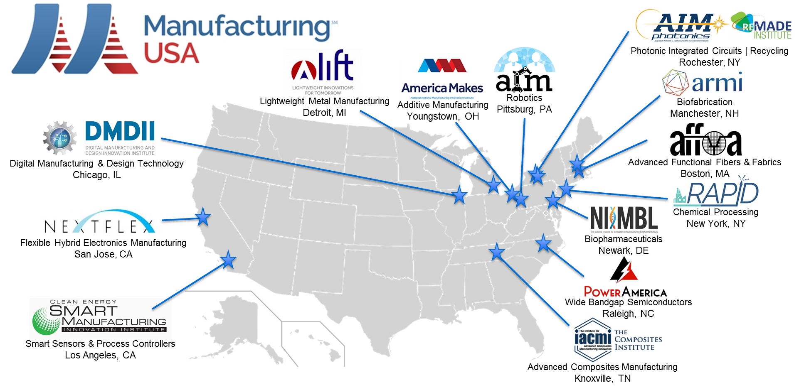
Manufacturing USA exists to allow U.S. manufacturers to lead the disruptive innovation impacting their industries

Slide 3
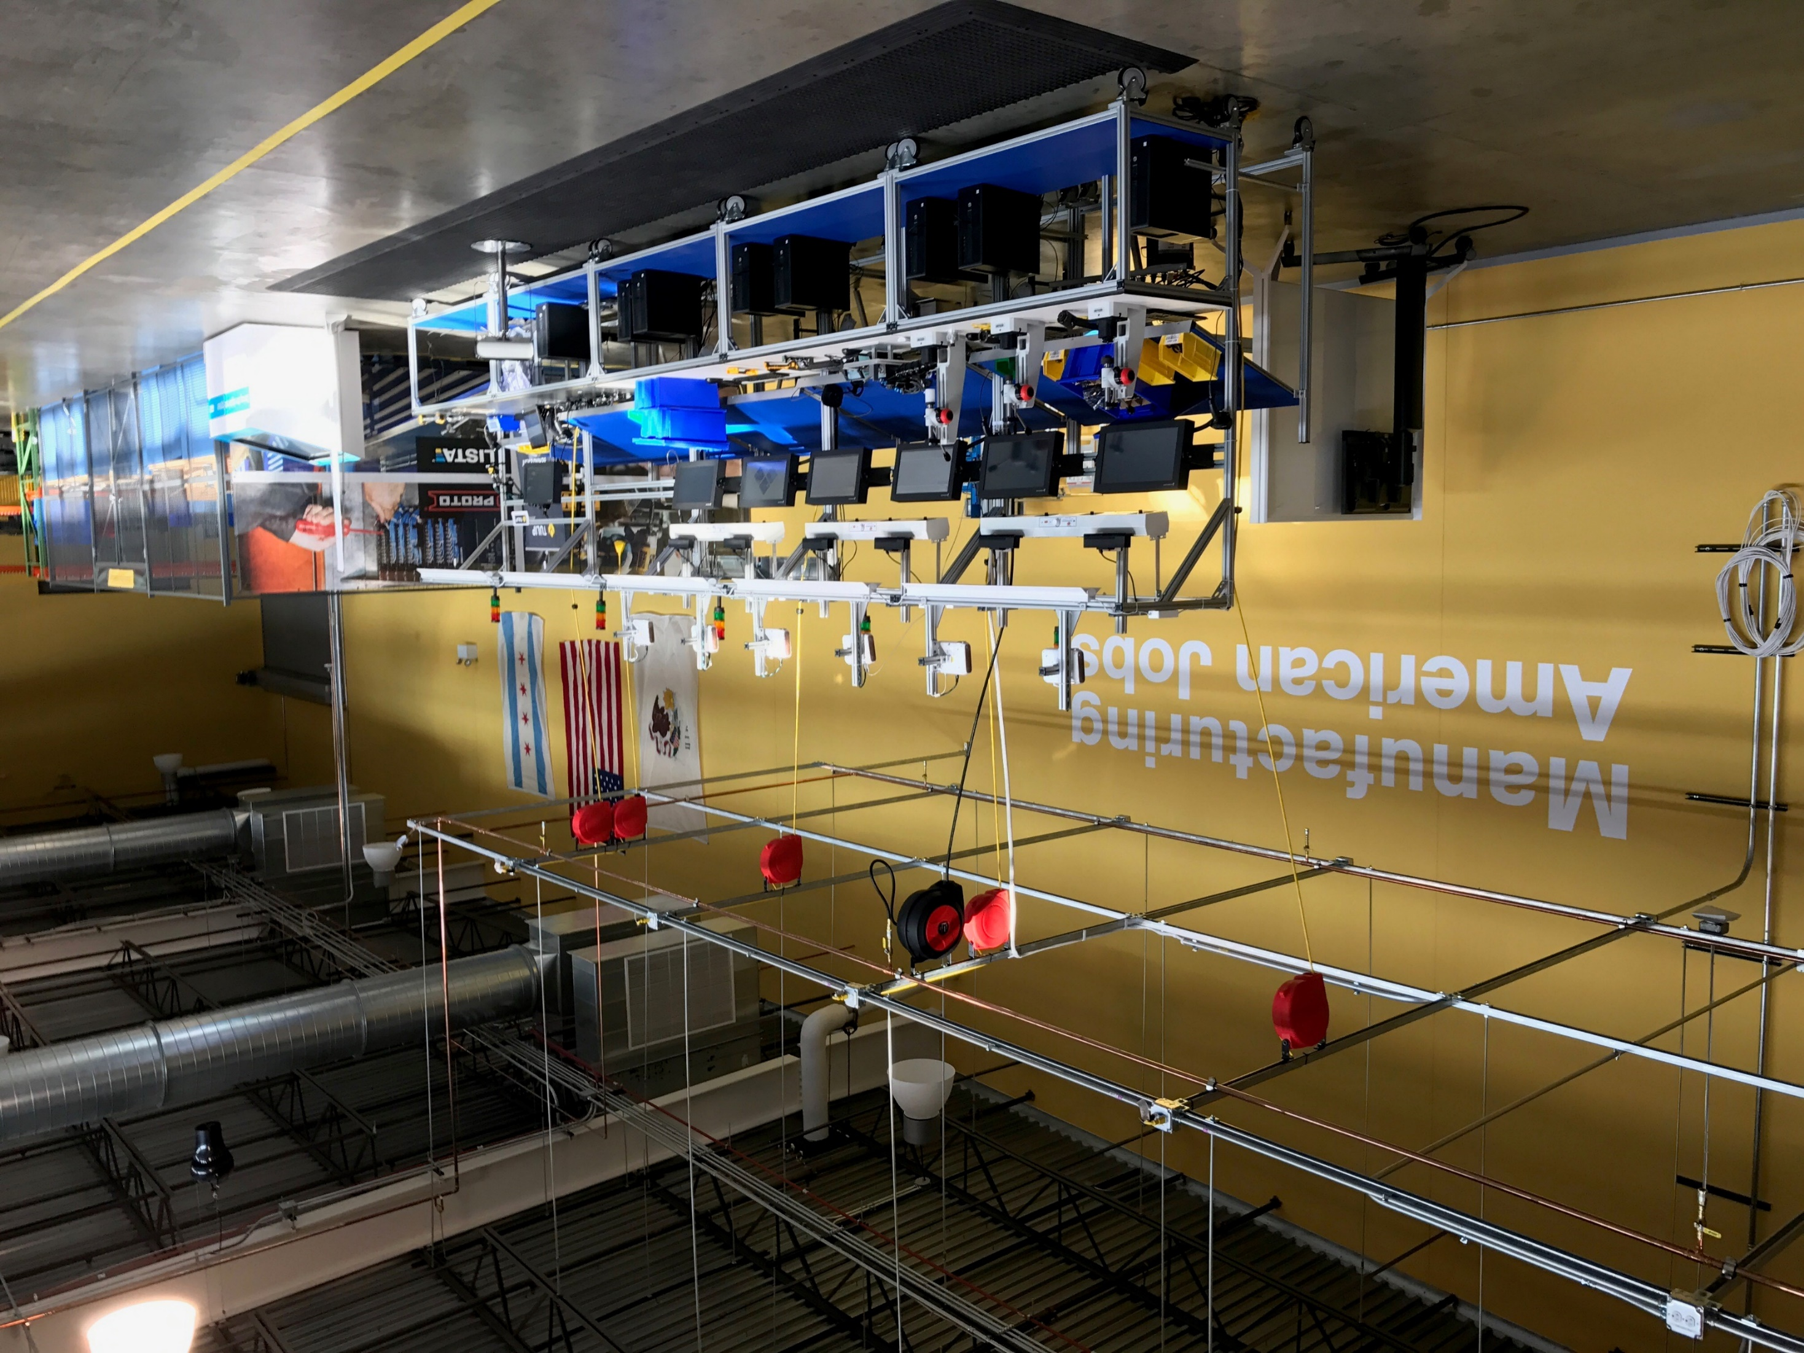
DMDII exists to transform American manufacturing competitiveness by accelerating the development and adoption of digital technology across the manufacturing enterprise

Slide 4
The advanced manufacturing opportunity required end-to-end thinking and the digitization and integration of data across the value chain to drive insights and improved operational performance
Tier 2 Supplier
Annual new data stored by sector
Petabytes
Tier 1 Supplier
Manufacturing
Tier 1 Supplier
Government
PRODUCT LIFECYCLE
Banking
Communications and Media
FABRICATE
QUALIFY
AFTER-
SALES
SERVICE
Retail
DESIGN
ASSEMBLE
SELL &
DELIVER
END OF
LIFE
REUSE
RECYCLE
Professional Services
Securities and Investment Services
Healthcare
111101001011
Education
1101001001000111101101010110011101111101
101011011010000101001001000111101111101010111101000011110101111101111
Insurance
010101001101010101101101010100100100101001001000111101010101111011111010111110111110010100101111
10110110101010101000001101010101101101010100101001001011110100101101110010001111010101111011111010111110111110101111101111101
Transportation
00010010101011110101010010010001111011010001001000110101010110110101010001010101101101011010011110111110101111101111101011111011111010111110010101100111
10111101101001111011101101010101011001011010010001101010101101101010100100100011110101001010010010001111010111111110111110101111101111101011111011111010111110111110101100010100101111
Wholesale
“Advanced digital technologies are creating new opportunities for innovation and growth, and producing novel ways to improve and customize the customer experience. This digitally driven evolution—which lays the foundation for what Deloitte calls the digital manufacturing enterprise (DME)—is enabled by the rise of Industry 4.0.
That digital information is then analyzed and used to drive further intelligent action in the physical world, completing a physical-to-digital-to-physical loop of action and informed reaction.”
- Deloitte¹
Utilities
Resource Industries
Consumer and Recreational Services
Construction
SOURCE: IDC; McKinsey Global Institute analysis 2013
Source: Deloitte article, Industry 4.0 engaged customers

Slide 5
Multiple technology shockwaves are impacting the manufacturing sector simultaneously
The speed and scope of the technological shockwave currently gathering momentum is unprecedented
- PwC
Digital human behavior
Artificial intelligence (AI)
Internet of Things (IoT)
Robotics
Augmented reality & virtual reality
Additive manufacturing
Augmented reality & virtual reality

Slide 6
Industry 4.0 will drive a revenue growth of about €30 billion a year - BCG
Industry 4.0 through data efficiency could improve productivity by about 25 percent
- McKinsey
72% of the companies expect to achieve advanced levels of digitization by 2020
- PwC
Industry 4.0
Future of American Manufacturing will depend on robotics, additive manufacturing, IoT, etc. - Journal of Economic Perspectives
Majority of companies believe that Industry 4.0 will increase their competitiveness.
- Deloitte
Notes:
BCG Source - https://www.bcgperspectives.com/content/articles/engineered_products_project_business_industry_40_future_productivity_growth_manufacturing_industries/?chapter=3
PwC Source - http://www.pwc.com/gx/en/industries/industry-4.0.html
McK Source - http://www.mckinsey.com/business-functions/operations/our-insights/manufacturings-next-act

Slide 7
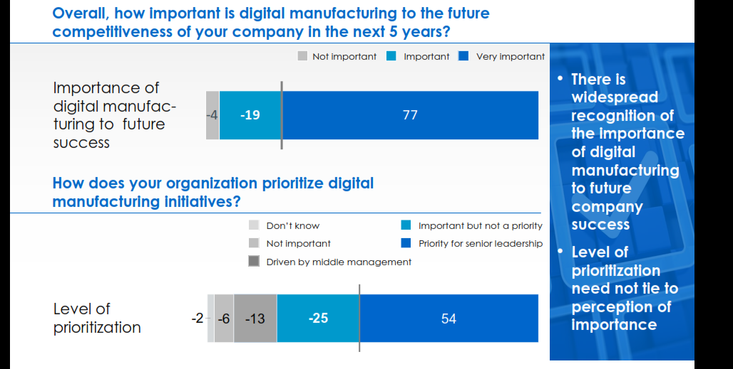
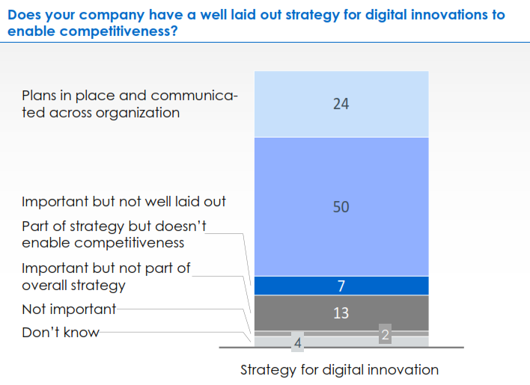
Industry leaders see the value of advanced manufacturing
Most stakeholders see digital manufacturing as key to long term competitiveness
Many companies do not have an effective strategy in place to capture that value
Source: Survey, July 2015, 200+ participants from industry, academia and the federal government

Slide 8
Advanced Manufacturing has the potential to drive step change improvements in manufacturing performance
Business value
Levers
EBIT impact potential¹
Labor productivity
Resource productivity and efficiency
5-7%
Quality management
Speed to market
4-7%
Asset utilization
Customization to individual customer needs
6-15%
Raw materials and inventory
Agility to changing customer needs
4-5%
Potential EBIT improvement
Value opportunity through new services
20%
35%
1 Impact range based on McKinsey digital compass diagnostic tool applied to a refrigeration compressor value chain

Slide 9
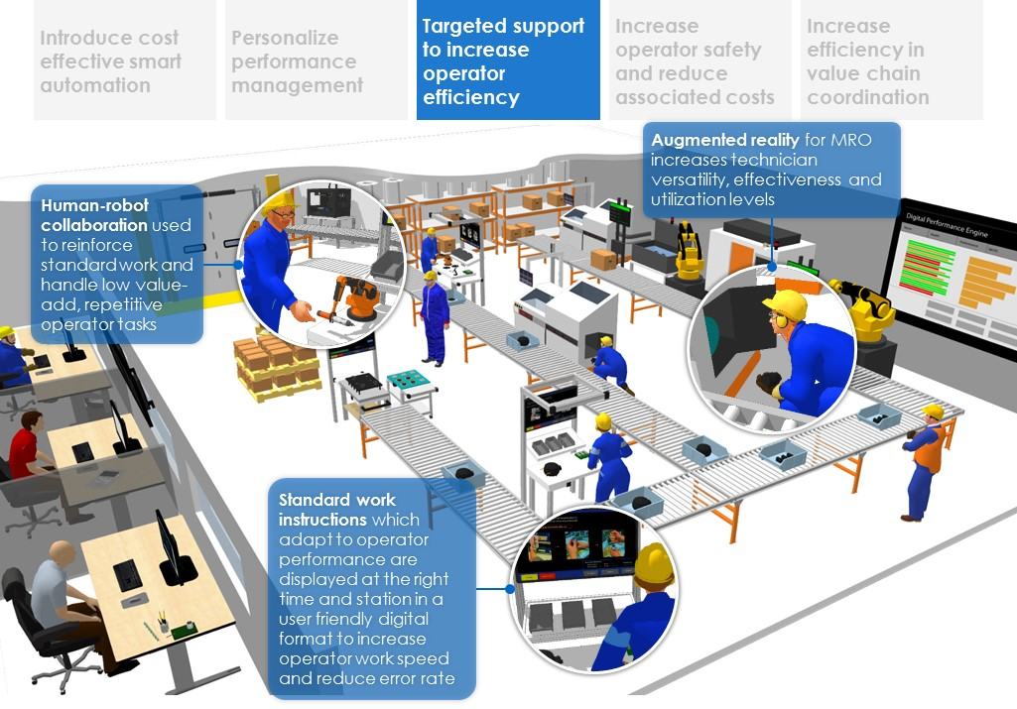
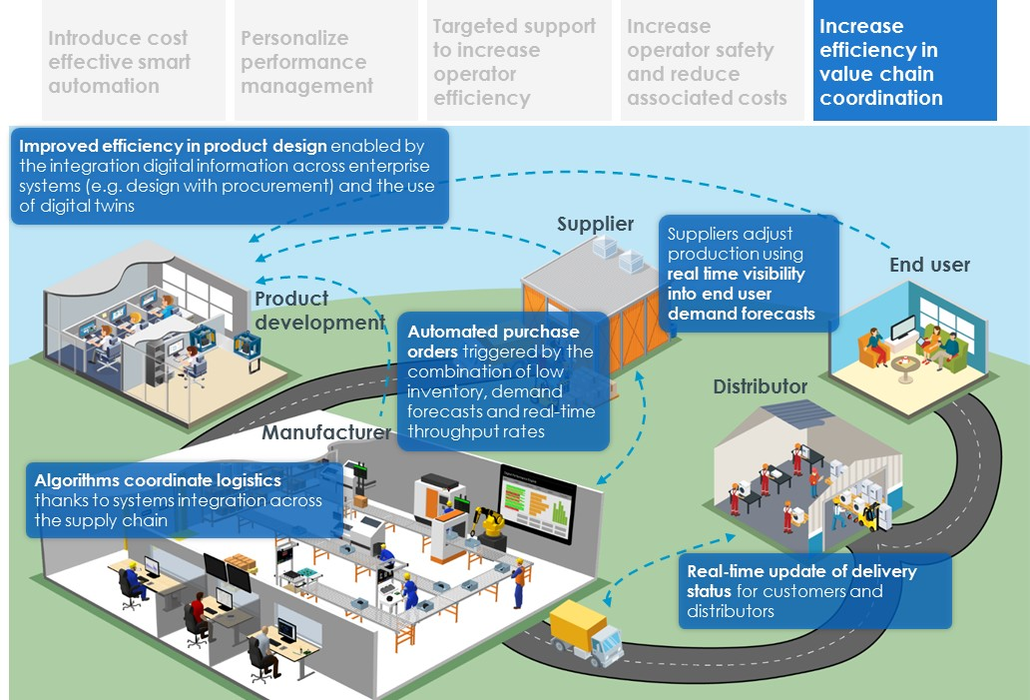
There are emerging technologies that will create disruptive capabilities for manufacturers
Examples of labor productivity levers & technology solutions
Source: McKinsey & DMDII Digital Blueprint

Slide 10
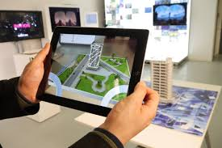
The opportunity is large but the landscape is complicated with hidden challenges
Opportunity
Technologies
Example technology partners
Introduce cost effective smart automation
Yield optimization through advanced analytics
Automated guided vehicles
Personalize performance management to improve operator effectiveness
Robotics
Digital performance management
Targeted support to increase operator efficiency
Part traceability and electronic records
Digital production planning and scheduling
Increase operator safety and reduce associated costs
Wearable technology & augmented reality
Digital standard work
Increase efficiency in value chain coordination
Digital supply chain collaboration and visibility
Digital twin

Slide 11
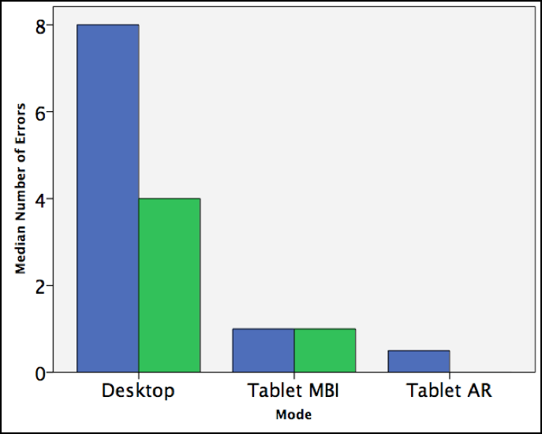
Augmented reality has the potential to drive both productivity and quality gains across a wide range of manufacturing environments
AUGMENTED REALITY EXAMPLE
Productivity improvements
Quality improvements
Aircraft wing first and second time quality rates
Without AR
100
+30%
With AR
130
First assembly
Second assembly

Slide 12
AR example

Slide 13
Machine learning and AI: What if a machine could automatically respond to its environment without the need for human intervention?
MACHINE LEARNING EXAMPLE
Machine learning coupled with adaptive control provides new capabilities to manufacturers of all sizes

Slide 14
Innovating as part of an ecosystem with deep expertise and diversity of thought is a requirement in the manufacturing world today
Aerospace & defense
Small to Mid-size Manufacturers
Partners come to DMDII to:
Share, learn and refine their digital strategies
Collaborate on R&D with unlikely partners
Accelerate awareness and adoption across the value chain
Industrial equipment
CPG
High growth Startups +
Technology Providers
Chemicals & agriculture
Automotive
Pharma & medical products
Universities + Community Colleges
Tech
Services

Slide 15
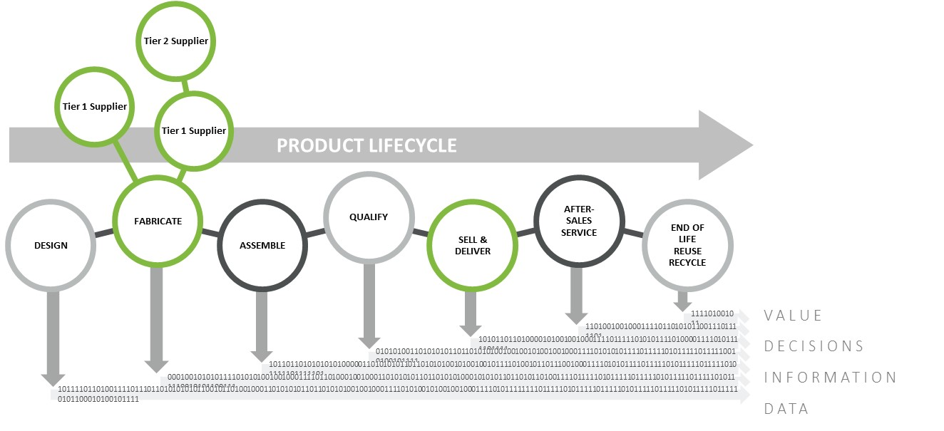
Multiparty collaboration is an important component of a manufacturers innovation strategy
Automated Manufacturability Analysis
Provides designers with summary data so that they can see the impact of their design iterations on manufacturability across multiple processes at any point during conceptual design.
PSU, Univ. Alabama Birmingham, Deere & Co., MFG.com, Lucrum Group, Techsoft 3D, American Foundry Society of America, NA Die Casting Association
Shop Floor Augmented Reality and Wearable Computing
Augmented Reality Expert Demonstration Authoring (AREDA) product to provide a simple and intuitive method for rapidly authoring AR work instructions by tracking and recording the actual part manipulations of an expert using 3D cameras with advanced image processing and computer vision algorithms
Purdue Univ., Deere & Co., Boeing, Design Mill, Daqri

Slide 16
The workforce needs to be prepared to incorporate advanced manufacturing technology
In partnership with Manpower Group and DMDII partners 165 manufacturing jobs that will be impacted by digital manufacturing technology were identified
Roles were prioritized and success profiles were developed for those roles
Many of the roles that were identified don’t exist today as well understood jobs

Slide 17
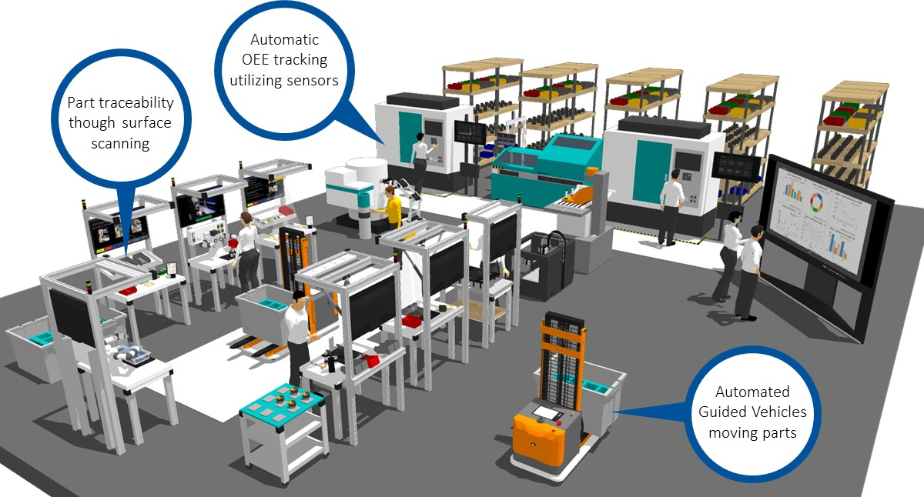
Development of new technology is not enough; people and processes in manufacturing need new capabilities to effectively utilize it
Future Factory Platform
A neutral space for experimentation, testing and development of next generation Digital Manufacturing solutions
Digital Capability Center
A Dedicated training environment to teach core Digital Manufacturing concepts

Slide 18
Questions?
Thomas McDermott
Executive Director, Digital Manufacturing & Design Innovation Institute
thomas.mcdermott@uilabs.org

