Slide 1
U.S. Manufacturing: Past Trends, Future Prospects and Needed Policies
Robert D. Atkinson
President, ITIF
September 7, 2017
@RobAtkinsonITIF
@ITIFdc

Slide 2
About ITIF
Independent, nonpartisan research and education institute focusing on intersection of technological innovation and public policy, including:
Innovation and competitiveness
IT and data
Telecommunications
Trade and globalization
Life sciences, agricultural biotech, and energy
Top science and tech think tank in the U.S., number two in world, according to University of Pennsylvania Go To Think Tank Index

Slide 3
Relevant ITIF Reports
“Trade vs. Productivity: What Caused U.S. Manufacturing's Decline and How to Revive It”
“Ten Principles to Guide the Trump Administration's Manufacturing Strategy”
“The Myth of America’s Manufacturing Renaissance: The Real State of U.S. Manufacturing”
“A Critique of CRS’s ‘U.S. Manufacturing in International Perspective’”
“Worse Than the Great Depression: What the Experts Are Missing About American Manufacturing Decline”
“A Policymaker’s Guide to Smart Manufacturing”
“How Cloud Computing Enables Modern Manufacturing”

Slide 4
Today’s Presentation
What’s Happened to U.S. Manufacturing?
Smart Manufacturing Opportunities
What is the Role of Government in Helping Manufacturers?
1
2
3

Slide 5
U.S. Manufacturing Plants Have Been Getting Smaller
Average manufacturing plant size (employment)
Source: U.S. Census Bureau, Statistical Abstracts of the United States (various, 1900 to 1987)

Slide 6
Manufacturing Firms Have Been Getting Smaller
Change in U.S. Establishment Size by Industry, 1997-2012
Source: U.S. Census Bureau, Statistical Abstracts of the United States (various, 1900 to 1987)
Notes:
From 1997 to 2012 average firm size increased 6.6 percent, from 19 employees to 20.2, and up from 17.6 in 1987. (see figure 1) But this masked considerable differences among industries. The average number of jobs in manufacturing firms fell 22 percent, with apparel manufacturing firms down 35 percent, textiles down 34 percent, and computer and electronic products down 23 percent
There were only two industries in which large establishments lost share: farming, fishing and hunting, and manufacturing 92 -2012

Slide 7
Large Manufacturing Establishments Shrank More
Between 2000 and 2014, the number of small manufacturing establishments (1 to 4 workers) declined by 14 percent, while the number of large (1000+) declined by 42 percent.
Fewer small firms got big. In 1980, 110 establishments with more than 1,000 workers were 3 years old or less. By 2014, just 18.
At the firm level, the share of manufacturing workers employed by firms employing 5,000 or more workers fell from 46 percent in 1977 to just 15 percent in 2005.
Source: Census Longitudinal Business Database 1977-2014 http://www2.census.gov/ces/bds/estab/age_size_sector/

Slide 8
Causes: Technology and Trade
Flexible manufacturing technologies enable more efficient shorter production runs and more product variety, both of which enable smaller establishment size.
China trade likely impacted led to decline, especially in larger establishments.

Slide 9
How is U.S. Manufacturing Doing Today?
Conventional Claims:
Manufacturing output and exports at all-time levels
U.S. global share unchanged
Manufacturing job loss due to technology, not trade

Slide 10
CLAIM: Manufacturing Exports At All-Time High
REALITY:
GDP at all time high, imports even higher
Exports have grown, but imports have grown faster
Manufacturing trade deficit up 35% since 2012

Slide 11
CLAIM: Manufacturing Output At All-Time High
“U.S. factories produce twice as much stuff as they did in 1984.”
—Rex Nutting, MarketWatch, 3/28/2016
REALITY:
GDP grew even faster (up 230 percent)
Manufacturing output down 1% since 2007, while GDP is up 10%

Slide 12
CLAIM: U.S. Global Share Unchanged
“The U.S. share of global manufacturing has held at around 20 percent for 40 years.”
—Robert Zoellick, WSJ, 8/7/2016
REALITY:
In fact, it has declined by 7 percentage points since 2000.

Slide 13
CLAIM: High Productivity Led to Most of Manufacturing Job Loss
“Manufacturing employment has fallen because of productivity growth, not a decline in output.”
—Congressional Research Service
REALITY:
Then why did we lose 2.4% of manufacturing jobs in the 90s when manufacturing productivity growth was similar?

Slide 14
REALITY: USG Overstates Manufacturing Output Growth
Computers and electronics (NAICS 334) accounted for 111% of U.S. manufacturing value added growth from 2005 to 2015

Slide 15
REALITY: Most Manufacturing Industries Are Producing Less
Real manufacturing value added grew 2% from 2008 to 2015
Rest of the economy grew 11%
14 of 19 manufacturing sectors lost output

Slide 16
Manufacturing Productivity Growth Rates Down
Source: BLS Labor Productivity and Costs

Slide 17
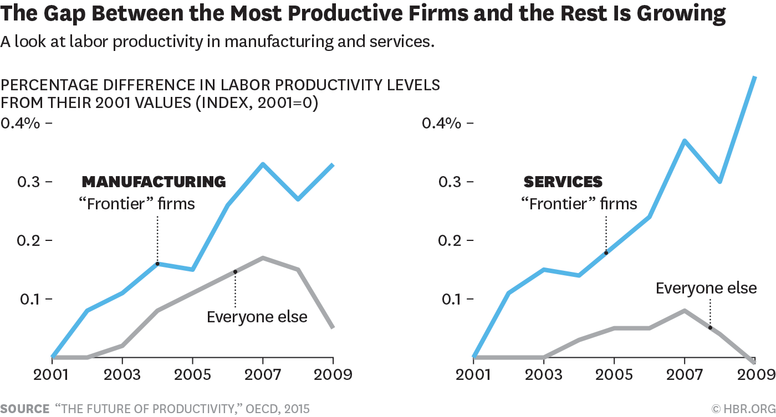
Digital Production Systems Are Creating Large Gaps Between the Most Productive Firms and the Rest

Slide 18
Today’s Presentation
What’s Happened to U.S. Manufacturing?
Smart Manufacturing Opportunities
What is the Role of Government in Helping Manufacturers?
1
2
3

Slide 19
Evolution of Manufacturing: Tomorrow
Source: Rebecca Taylor, National Center for Manufacturing Sciences, Do It In Digital: Virtualization and Tomorrow’s Manufacturing

Slide 20
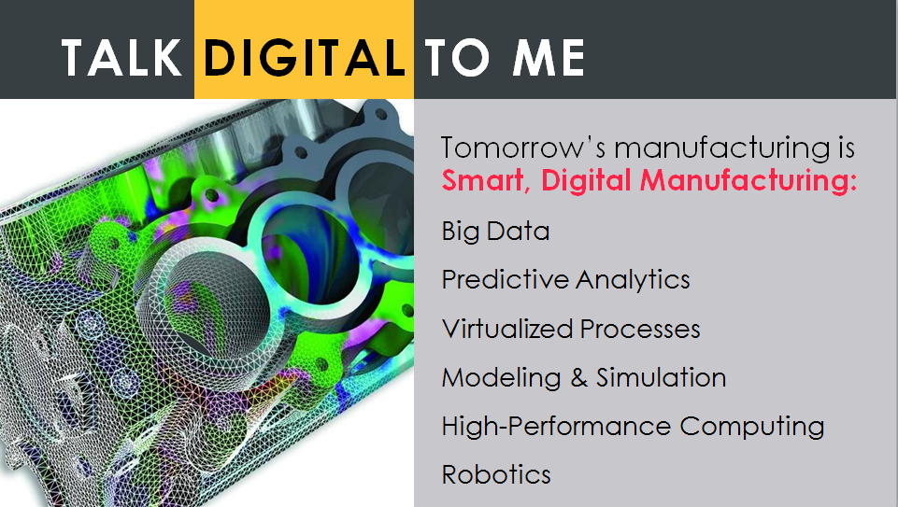
Evolution of Manufacturing: Tomorrow
"Smart manufacturing” will generate $371 billion in global value over the next 4 years: by 1) creating value from data and 2) streamlining design processes, factory operations, and supply chain risks. (IDC)

Slide 21
Smart Manufacturing
All “smart products” share three key components:
Physical components: E.g., Mechanical and electrical parts.
Smart components: E.g., sensors, microprocessors, data storage, controls, software, an embedded operating system, and a digital user interface.
Connectivity components: E.g., Wireless connectivity, ports, antennas, etc.

Slide 22
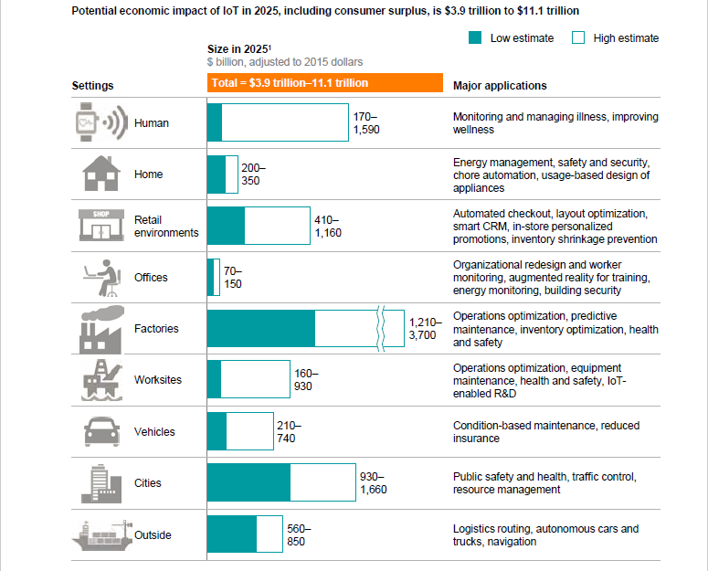
Manufacturing Poised to See Biggest Gains from IoT
Source: McKinsey Global Institute, The Internet of Things: Mapping the Value Beyond the Hype

Slide 23
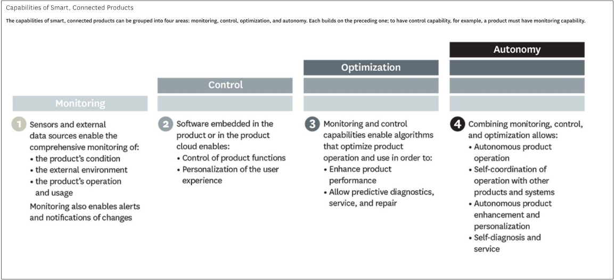
Maturity Scale for Smart Manufactured Products
Source: HBR, How Smart Connected Products are Transforming Competition

Slide 24
IoT & Supply Chain Management
IoT can help manufacturers better manage their supply chains.
BMW: Knows the real-time status of all machines producing all parts/components from all suppliers going into vehicles.
Toyota: Reduces recalls by knowing exactly what machine produced which components of which vehicles.
HP: Integrates network analysis and data visualization into its supply chain management and monitoring; has reduced the time for supply chain management projects by up to 50%.

Slide 25
IoT & Manufacturing Operating Efficiency
Explosion of low-cost sensor technologies has made every manufacturing process and component a potential data source.
Ford: Placed sensors on virtually every piece of production equipment at its River Rouge facility.
GM: Uses sensors to monitor humidity conditions during vehicle painting; if unfavorable, the work piece is moved elsewhere in plant or ventilation systems adjusted.
Raytheon: Keeps track of how many times a screw has been turned in its factories.
Merck: Improves vaccines by conducting up to 15 billion calculations to determine what environmental and process factors influence quality of final product.

Slide 26
IoT & Predictive Maintenance
IoT expected to reduce factory equipment maintenance costs by up to 40%.
Expected to reduce equipment downtime by up to 50% and is expected to reduce capital equipment investment costs 5%.
Generating economic value of $630B annually by 2025.

Slide 27
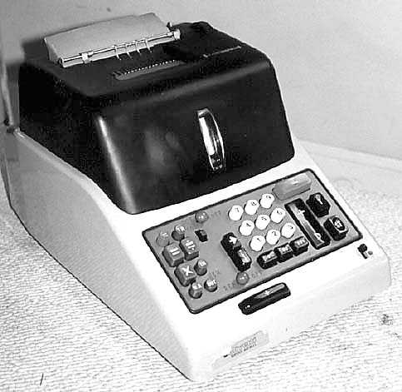
Tech Innovation Progresses Along S-Curves
Electro-Mechanical
Tech System
Takeoff Installation Slowdown
1945-58 59-74 74-93

Slide 28
No: Tech Innovation Progresses Along S-Curves
Electro-Mechanical
Tech System
Digital Electronic
Tech System
Takeoff Installation Slowdown Takeoff Installation Slowdown
1945-58 59-74 74-93 94-2000 2001-2010 2011-27

Slide 29
No: Tech Innovation Progresses Along S-Curves
Electro-Mechanical
Tech System
Digital Electronic
Tech System
AI-Robotics
Tech System
Takeoff Installation Slowdown Takeoff Installation Slowdown Takeoff Installation
1945-58 59-74 74-93 94-2000 2001-2010 2011-27 2028-39 2039-??

Slide 30
Today’s Presentation
What’s Happened to U.S. Manufacturing?
Smart Manufacturing Opportunities
What is the Role of Government in Helping Manufacturers?
1
2
3

Slide 31
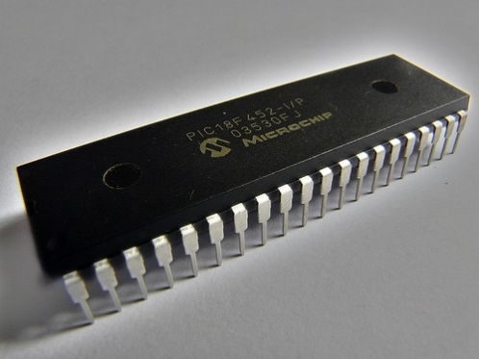
Manufacturing Policy Must Get the 4 “Ts” Right
Trade | Tax
Technology | Talent
Macro
Micro
31

Slide 32
Manufacturing Policy Should Encourage the High Road
There is more than one “production recipe.” The “high road” recipe involves greater use of capital equipment, more reliance on skilled workers and their knowledge, and greater focus on innovation.
0.7 correlation between payroll per employee and value-added per employee
0.6 correlation between payroll and capital expenditures
Firms with higher payroll per employee have more skilled workers.
Source (Susan Helper and Ryan Noonan, “Taking the High Road: New Data Show Higher Wages May Increase Productivity, Among Other Benefits, U.S. Department of Commerce, Aug 4, 2015)

Slide 33
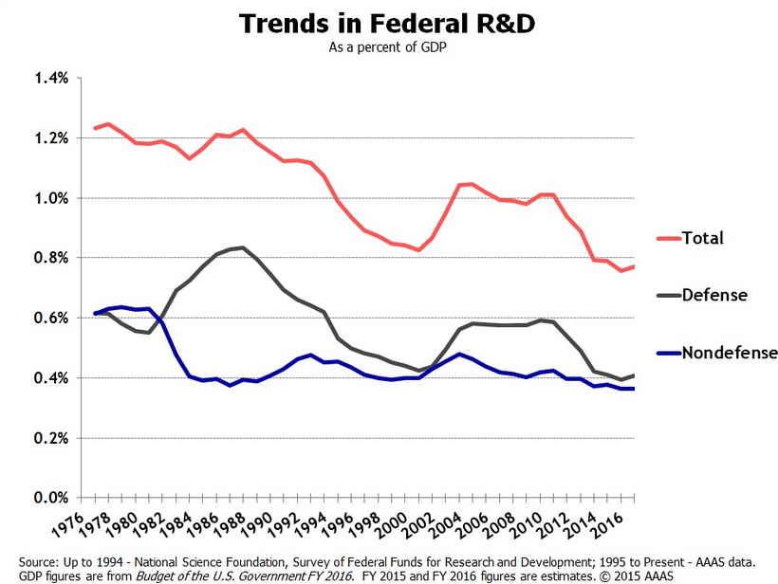
Federal R&D Funding Is Down

Slide 34
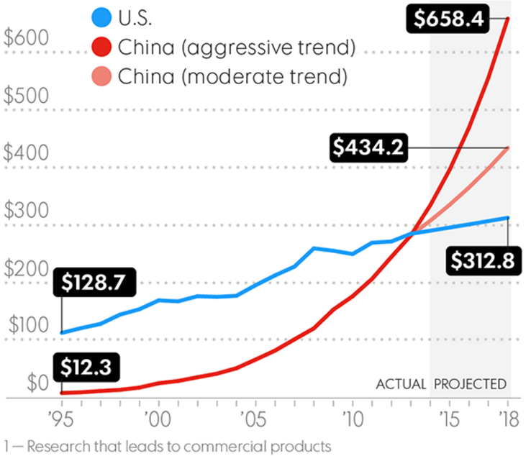
China Outspends the U.S. in Late-Stage R&D
Source: Boston Consulting Group Analysis of National Science Board, Science and Engineering Indicators 2016, Organisation for Economic Co-Operation and Development Data

Slide 35
Uncompetitive Tax System
Highest corporate tax rate in the OECD.
Highest effective corporate tax rate for manufacturers among 13 major nations.
29th least generous R&D tax incentive
Weak investment tax incentives
No “innovation box” incentive
Territorial tax system

Slide 36
Weak Smart Manufacturing Policies
Country | Smart Manufacturing Policy/Program | Investment Level
Austria | R&D projects associated with Industry 4.0 | €250/$300 Million
China | Made in China 2025 Program Implementation Plan for the 2016 Intelligent Manufacturing Pilots Special Project | “Enormous”
Germany | To help industry associations, research institutes, and companies create Industry 4.0 implementation strategies. | €200/$300 Million
United Kingdom | High-Value Manufacturing Catapult, a network of seven advanced manufacturing technology institutes, including a Manufacturing Technology Centre (MTC). | £140/$220 Million (Over next 5 years)
European Union | Horizon 2020 allocates funds for “leadership in deploying key enabling and industrial technologies.” | €16B/$23B (Total seven years to 2020)
United States | 2 Related NNMIs – Digital Manufacturing and Design Innovation Institute (DMDII) and New Smart Manufacturing Institute | $140M in federal funds, matched 2:1

Slide 37
Weak Manufacturing Skills Systems
Global leaders (Austria, Germany) have systems of industry-led industry training centers and apprenticeship programs’.

Slide 38
Anemic Investment in SME Support Systems
Competitors invest much more on per-GDP basis (Canada 10x; Germany 20x; Japan 40x).
Other nations invest in “innovation voucher” programs for small manufacturers (Austria, Belgium, Canada, Denmark, Germany, the Netherlands, Ireland, and Sweden).

Slide 39
Promising Steps: Manufacturing Skills Act (S. 1542)
Creates annual $100 million competition to promote reforms in workforce education and skills training for manufacturing in states and metropolitan areas.
Stakeholder task force would conduct SWOT assessment of regional mfg. assets and capacities.
Grant awards of $10 million for three years to up to five states and five metropolitan areas with the strongest and most comprehensive proposals.
Bipartisan legislation sponsored by Coons (D-DE) & Ayotte (R-NH)

Slide 40
Promising Steps: Manufacturing Universities Act
Goal: Better prepare university engineering programs to produce engineers better-prepared for careers in innovation and advanced manufacturing.
A competition to designate Mfg. Universities, that would receive $5 million annually for four years to: Improve engineering programs to emphasize manufacturing; Increase joint projects, co-ops, with manufacturing firms; Increase numbers of engineering or mfg-related graduates; Have universities designate Chief Mfg. Officers.
Bicameral, bipartisan legislation (S. 771/H.R. 1441), Coons, Gillibrand, Ayotte, Graham, Baldwin, Kirk.

Slide 41
Promising Steps: MEP Improvement Act
Increase MEP authorization to $260 million/year through 2020.
Permanently adjust the federal MEP cost share to 1:1.
Require re-competition of all MEP centers every 10 years.
Involve MEPs more in mfg.-related apprenticeships.
Sponsored by Coons, Ayotte, and Peters.

Slide 42
Promising Steps: Innovative Skills Programs
More engineering in high school (e.g., Purdue’s High School evGrandPrix; FIRST; SkillsUSA; SMU’s Infinity Project; Purdue Polytechnic Charter High School)
Advanced Manufacturing Training Centers (e.g., Francis Tuttle Technology Center in Oklahoma City; Learn Work Earn, MN; National Coalition of Certification Centers).
University programs that emphasize manufacturing (e.g., Haley Barbour Center for Manufacturing Excellence at University of Mississippi; Georgia Tech’s Manufacturing Center; University of Louisville engineering Co-op program).
Regional Skills Alliances (e.g., Southwest Virginia Alliance for Manufacturing, Wauskesha County Manufacturing Alliance [WI]; Manufacturing Alliance of Hillsborough County [FL].

Slide 43
Thank You!
Robert D. Atkinson | ratkinson@itif.org | @RobAtkinsonITIF
@ITIFdc

