Slide 1
Get with the Program
Digitalizing America’s Advanced Manufacturing Sector
Mark Muro
Brookings Metropolitan Policy Program
NACFAM
September 7, 2017
@MarkMuro1

Slide 2
1
Digitalization: What it is; why it matters
2
A new analysis and national trends
3
Digitalizing advanced manufacturing

Slide 3
1
Digitalization: What it is; why it matters
2
A new analysis and national trends
3
Digitalizing advanced manufacturing

Slide 4
Technological innovations are transforming our economy
Relentless pace of technological change
Rapidly changing business models
“Digitalization of everything”
Notes:
Edit economy overview slide with a more digital image (more guidance coming)

Slide 5
A whole new world beckons
Virtual design and simulation
Internet of Things
Manufacturing as a service
Big Data analytics
Manufacturing “start-ups”
Notes:
Here we need a slide that prompts the group for discussion of the new digital technologies that are remaking the manufacturing now, including:
Visualization and simulation software
3-D printing
Advanced robotics
Internet of Things
Can you help design a slide that fits into the format and look of the deck and perhaps:
Depicts some of these techs
Suggests change they are creating

Slide 6
What we mean by “digitalization”
Digitalization is the process of employing digital technology and data to transform business operations and create value
Notes:
What is “digitization?”
Digital as general purpose technology
Pervasive, transformative—info from Brynjolffssen, McKinsey, Brandstetter coming

Slide 7
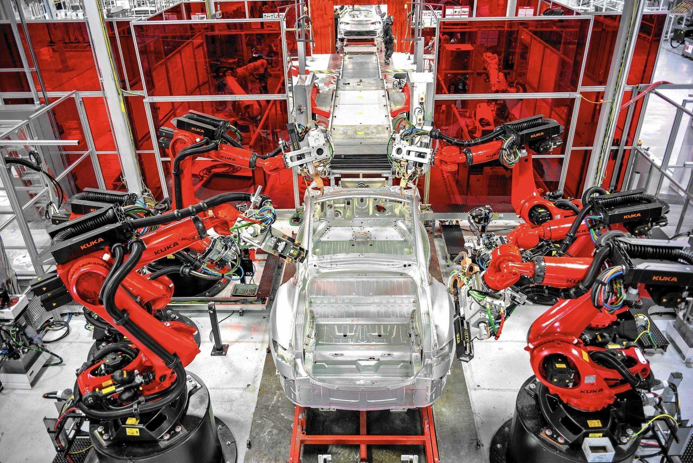
Opportunities include productivity gains and transformed industries
Notes:
Headline: An explosion of digital tools is transforming almost every industry
Left (tools): (Can ask Dustin for photo or other research)
Microsoft Office logo
Salesforce logo
Amazon Web Services image or logo
Image of a phone running an app
Image for artificial intelligence (small block of 0s and 1s?)
Right: Images or logos for industry change
Robotic mfg (Tesla factory)
Amazon same-day delivery in retail (pic of Amazon truck)
Ride-sharing (Uber)
Health IT
Education online (MOOCS)

Slide 8
Challenges include an IT skills gap and limited overall digital proficiency
1 in 6
working-age Americans are unable to use email, web
search, or other basic online tools
100,000
60,000
Source: BLS Presentation, 2016
Source: OECD

Slide 9
1
Digitalization: What it is; why it matters
2
A new analysis and national trends
3
Digitalizing advanced manufacturing

Slide 10
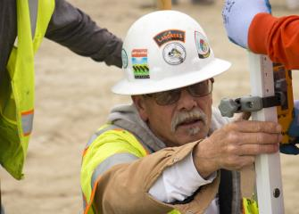
How we studied digitalization
Comprehensive digitization score from 1 to 100
Two categories of O*NET digitalization data
545
occupations
Software Developers, | 94
Computer Systems Analysts | 79
Lawyers | 58
Construction Supervisors | 55
Registered Nurses | 55
Security Guards | 31
Restaurant Cooks | 18
Construction Laborers | 17
Personal Care Aides | 14
Knowledge of Computers and Electronics
Interaction with Computers
91%
of the U.S.
labor force

Slide 11
We sorted occupations by high, medium, & low digital requirements
High
(digital scores above 60)
Medium
(digital scores between 33 and 60)
Low
(digital scores below 33)
Software Developers
Financial Managers
Lawyers
Registered Nurses
Security Guards
Restaurant Cooks
Computer Systems Analysts
Market Research Analysts
Automotive Services Technicians and Mechanics
Office Clerks
Construction Laborers
Personal Care Aides

Slide 12
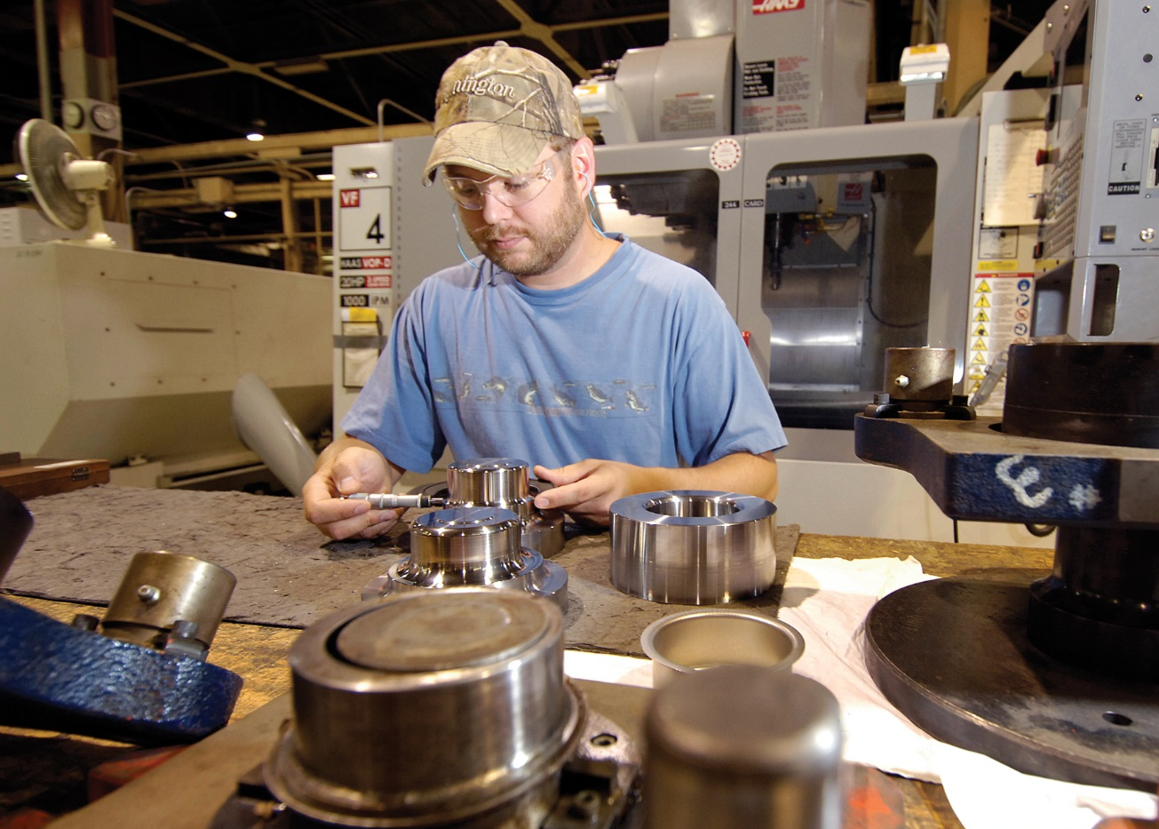
The share of jobs requiring high & medium digital skills has skyrocketed
Share of U.S. employment by digital skill level
Administrative support
39
64
Tool & die makers
3
51
Notes:
National change over time

Slide 13
Industry digitalization varies widely
Share of sector employment by digital score, 2016
Higher paying
Lower paying

Slide 14
Digitalization drives industry productivity growth
Annualized Productivity Growth by Sector, 2010 - 2016
Oil & Gas Extraction
Information technology
Advanced Manufacturing
Media
Wholesale trade
Retail Trade
Management
Healthcare Services
Finance
Educational Services
Mining (except Oil & Gas)
Notes:
National change over time

Slide 15
1
Digitalization: What it is; why it matters
2
A new analysis and national trends
3
Digitalizing advanced manufacturing

Slide 16
Digitalization is a defining trend in advanced manufacturing

Slide 17
The sector is rapidly digitalizing
Employment in advanced manufacturing by digital skill level
Advanced Manufacturing Sector
24
Digital score, 2002
39
Digital score, 2016
Notes:
21.
Left panel: Display 2002 and 2016 median digital scores with arrow pointing from 02 to 16
Sub for “76^{th”} the region’s ranking for score change and label as:
Upskilling rank among largest 100 metros

Slide 18
Advanced manufacturing occupations are changing
Tech-oriented occupations are increasing their share of advanced manufacturing employment at the expense of routine occupations
Occupation Name | Job Change, 2002-16 | Avg. Annual Growth Rate, 2002-16
Software developers, systems software | +73,130 | — *
Software developers, applications | +51,900 | — *
Operations research analysts | +3,050 | 6.0%
Graphic designers | +6,720 | 5.6%
Computer systems analysts | +5,520 | 1.6%
Advanced Manufacturing | +190,360 | 0.3%
Welders, cutters, solderers, and brazers | -1,810 | -0.1%
Painters, transportation equipment | -3,600 | -1.7%
Machine feeders and offbearers | -18,550 | -8.2%
*No advanced manufacturing jobs in this occupation in 2002
Notes:
25. Create new slide showing fast growth of key, larger, big changing occupations’ digital scores in auto along lines of existing good jobs slide
Show me candidate occupations; want to reality test them against things I’ve heard them talk about and my own knowledge

Slide 19
Advanced manufacturing occupations are changing
Digital skill ratings for occupations in advanced manufacturing
Notes:
25. Create new slide showing fast growth of key, larger, big changing occupations’ digital scores in auto along lines of existing good jobs slide
Show me candidate occupations; want to reality test them against things I’ve heard them talk about and my own knowledge

Slide 20
On-ramps to middle-class careers are rapidly upskilling
Digital skill ratings for key “opportunity jobs”
Notes:
28. FIX
Supervisors of Production workers
Sales representative for technical and scientific products
Tool and die makers
Plumbers
Firefighters
Dental hygenists
Computer numerically controlled machine programmers
Telecom line installers
Radiologic technologists
Physical therapist assistants
Electrical and electronics technicians

Slide 21
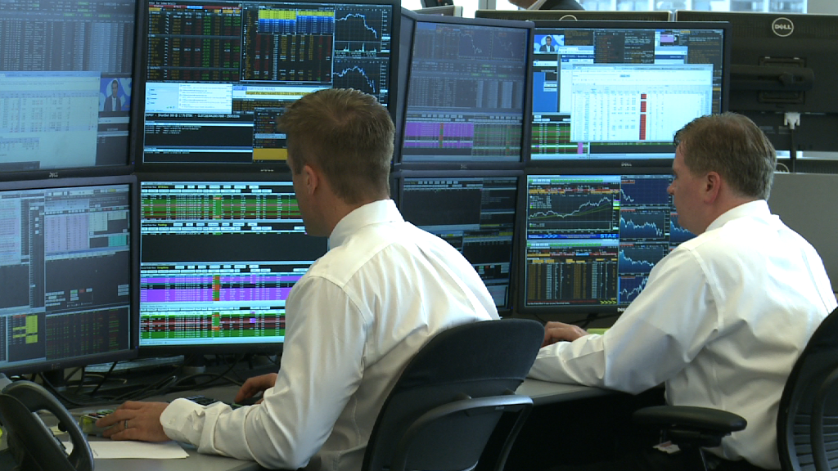
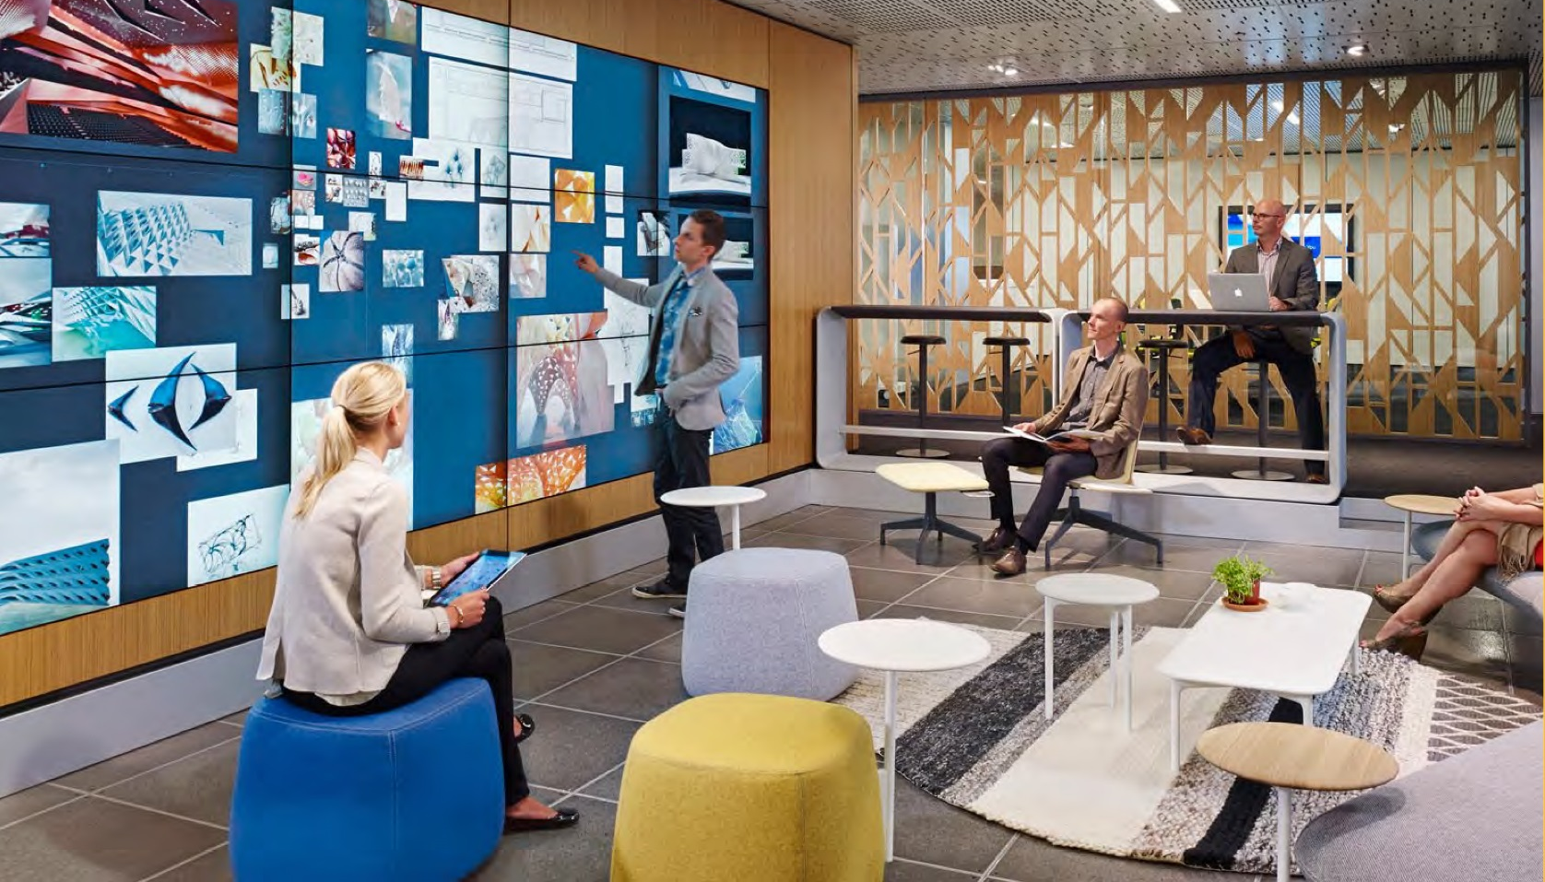
The industry should adopt two digital workforce agendas
1.
Commit to digital transformation
2.
Expand and widen
the digital talent pipeline

Slide 22
The industry should adopt two digital workforce agendas
Expand investment in digital-factory R&D and adoption
Embrace new open or networked tech models
Recognize the importance of young firms
1.
Commit to digital transformation

Slide 23
The industry should adopt two digital workforce agendas
Invest in upskilling incumbent workers
Expand work-based learning
Align and scale up education and tech training
Provide top-flight career on-ramps
2.
Expand and widen the digital talent pipeline

Slide 24
Finally: Cultivate what is “uniquely human”
Emphasize adaptability, creativity, continuous learning, and social skills over rote information processing

Slide 25
For more information:
Mark Muro
Senior Fellow
Metropolitan Policy Program at Brookings
mmuro@brookings.edu
@markmuro1

Slide 26
Get with the Program
Digitalizing America’s Advanced Manufacturing Sector
Mark Muro
Brookings Metropolitan Policy Program
NACFAM
September 7, 2017
@MarkMuro1

